Slide 1
Internet of Things
Introduction and Basic Concepts
Mehdi Rasti
Amirkabir University of Technology
spring-2020

Slide 2
Contents
Basic Concepts and History
Ecosystem
Things
Platform
Networks
Applications and Verticals
Architecture
Challenges
Business and Market Opportunities
Products
Trends
Mostly adopted from IoT Fundamentals: Networking Technologies, Protocols, and Use Cases for the Internet of Thing, Cisco press, 2017

Slide 3
Contents
Basic Concepts and History
Ecosystem
Things
Platform
Networks
Applications and Verticals
Architecture
Challenges
Business and Market Opportunities
Products
Trends

Slide 4
What is IoT?
Kevin Ashton, 2009
If we had computers that knew everything there was to know about things—using data they gathered without any help from us—we would be able to track and count everything, and greatly reduce waste, loss and cost. We would know when things needed replacing, repairing or recalling, and whether they were fresh or past their best. We need to empower computers with their own means of gathering information, so they can see, hear and smell the world for themselves.
* Internet of Things Challenges, Advances, and Applications, CRC Press, 2018

Slide 5
What is IoT?
ITU-T, 2012
Internet of things (IoT): A global infrastructure for the information society, enabling advanced services by interconnecting (physical and virtual) things based on existing and evolving interoperable information and communication technologies.
* Internet of Things Challenges, Advances, and Applications, CRC Press, 2018
Notes:
NOTE 1 – Through the exploitation of identification, data capture, processing and communication capabilities, the IoT makes full use of things to offer services to all kinds of applications, whilst ensuring that security and privacy requirements are fulfilled.
NOTE 2 – From a broader perspective, the IoT can be perceived as a vision with technological and societal implications.

Slide 6
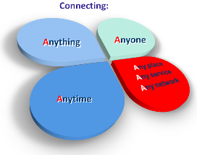
What is IoT?
IERC, 2014
A dynamic global network infrastructure with self-configuring capabilities based on standard and interoperable communication protocols where physical and virtual ‘things’ have identities, physical attributes, and virtual personalities and use intelligent interfaces, and are seamlessly integrated into the information network.
* Internet of Things Challenges, Advances, and Applications, CRC Press, 2018
* http://www.internet-of-things-research.eu/about_iot.htm

Slide 7
What is IoT?
ISO/IEC, 2015
An infrastructure of interconnected objects, people, systems, and information resources together with intelligent services to allow them to process information of the physical and the virtual world and react.
* Internet of Things Challenges, Advances, and Applications, CRC Press, 2018

Slide 8
What is IoT?
IEEE IoT, 2015
An IoT is a network that connects uniquely identifiable ‘Things’ to the Internet. Through the exploitation of unique identification and sensing, information about the ‘Thing’ can be collected and the state of the ‘Thing’ can be changed from anywhere, anytime, by anything.”
* Internet of Things Challenges, Advances, and Applications, CRC Press, 2018
Notes:
IEEE IoT, 2015
An IoT is a network that connects uniquely identifiable ‘Things’ to the Internet. The ‘Things’ have sensing/actuation and potential programmability capabilities. Through the exploitation of unique identification and sensing, information about the ‘Thing’ can be collected and the state of the ‘Thing’ can be changed from anywhere, anytime, by anything.”

Slide 9
What is IoT?
IoT is a world of interconnected things which are capable of sensing, actuating, and communicating among themselves and with the environment (i.e.,smart things or smart objects) while providing the ability to share information and act in parts autonomously to real/physical world events and by triggering processes and creating services with or without direct human intervention.
* Internet of Things A to Z : Technologies and Applications, IEEE Press, 2018

Slide 10

History of IoT
IoT was introduced by Kevin Ashton in 1999.
* http://blueapp.io/blog/a-brief-history-of-iot/

Slide 11

History of IoT
The first connected refrigerator announced by LG.
First Bluetooth enabled devices came out for personal use. This included printers, laptops, phones,
and PCs.
* http://blueapp.io/blog/a-brief-history-of-iot/

Slide 12

History of IoT
The term IoT becomes more popular
* http://blueapp.io/blog/a-brief-history-of-iot/

Slide 13

History of IoT
The Nabaztag was created by Rafi Haladjian and Olivier Mével. The little WiFi enbabled rabbit was able to alert and speak to you about stock market reports, news headlines, alarm clock, RSS-Feeds, etc as well as connect to each other
* http://blueapp.io/blog/a-brief-history-of-iot/

Slide 14
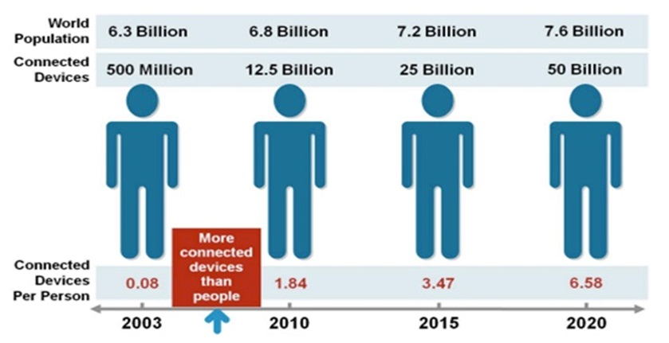

History of IoT
Devices connected to the internet exceed the number of people
* http://blueapp.io/blog/a-brief-history-of-iot/
* Cisco IBSG, April 2011
Notes:
According to Cisco Internet Business Solutions Group (IBSG), the Internet of Things was born in between 2008 and 2009 at simply the point in time when more “things or objects” were connected to the Internet than people.
Citing the growth of smartphones, tablet PCs, etc the number of devices connected to the Internet was brought to 12.5 billion in 2010 (Related: see Kevin Kelly's One Machine), while the world’s human population increased to 6.8 billion, making the number of connected devices per person more than 1 (1.84 to be exact) for the first time in history.

Slide 15

History of IoT
IPv6 public launch
The new protocol allows for 2¹²⁸ (approximately 340 undecillion or 340,282,366,920,938,463,463,374,607,431,768,211,456) addresses.
* http://blueapp.io/blog/a-brief-history-of-iot/

Slide 16

History of IoT
It is projected that anywhere from 26-50 billion devices will be connected to the internet by 2020.
* http://blueapp.io/blog/a-brief-history-of-iot/

Slide 17
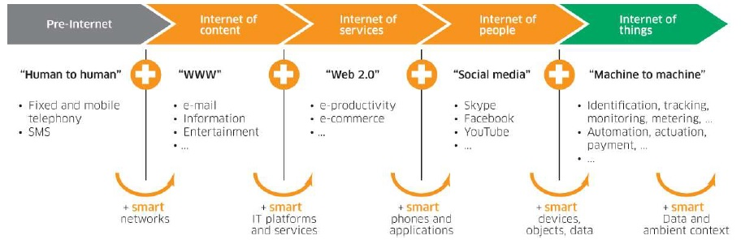
History of IoT
* Lecture, Internet of Things: An Introduction, Tecnico Ulisboa, 2018

Slide 18
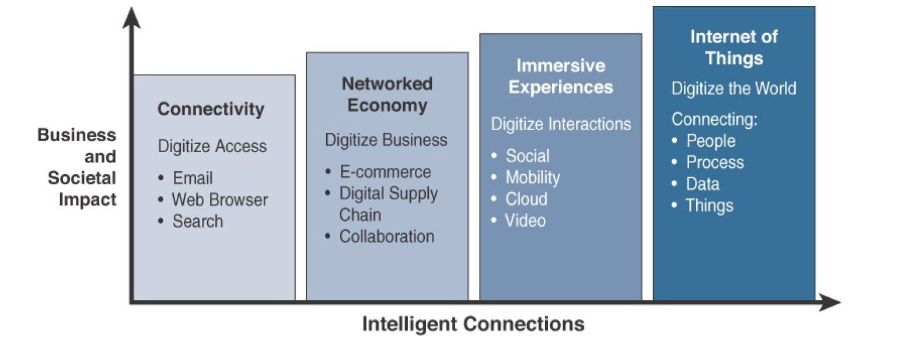
History of IoT
* IoT Fundamentals: Networking Technologies, Protocols, and Use Cases for the Internet of Thing, Cisco press, 2017
Notes:
Connectivity (Digitize Access): This phase connected people to email, web services and search, so that information is easily accessed.
Networked Economy (Digitize Business): This phase enabled e-commerce and supply chain enhancements along with collaborative engagement to drive increased efficiency in business.
Immersive Experiences (Digitize Interactions): This phase extended the Internet Experience to encompass widespread video and social media while always being connected through mobility. More and more applications are moved to Cloud.
Internet of Things (Digitize the World) This phase is adding connectivity to Objects and machines to the world around us to enable new services and experiences. It is connecting the unconnected.

Slide 19
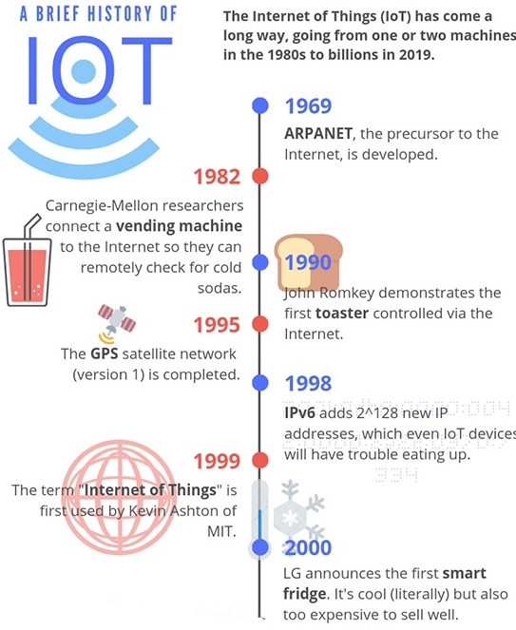
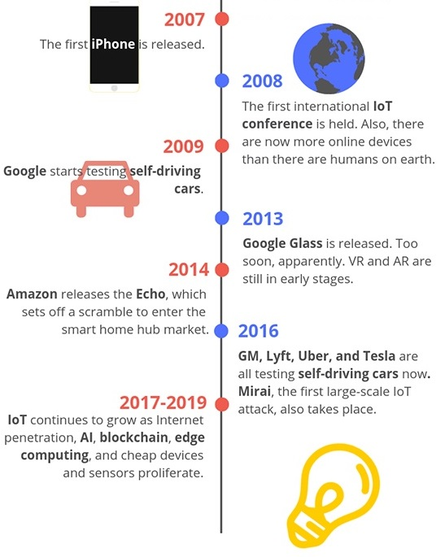
History of IoT
* https://www.iottechtrends.com/history-of-iot/
Notes:
1969: ARPANET, the precursor to the modern Internet, is developed and put into service by DARPA, the U.S Defense Advanced Research Projects agency. This is foundational to the “Internet” part of the Internet of Things.
1980s: ARPANET is opened up to the public by commercial providers, making it possible for people to connect things if they want to.
1982: Programmers at Carnegie Mellon University connect a Coca-Cola vending machine to the Internet, allowing them to check if the machine has cold sodas before going to purchase one. This is often cited as one of the first IoT devices.
1990: John Romkey, in response to a challenge, connected a toaster to the Internet and was able to successfully turn it on and off, bringing us even closer to what we think of as modern IoT devices.
1993: Engineers at the University of Cambridge, upholding the now well-established tradition of combining the Internet with appliances and food, develops a system that takes pictures of a coffee machine three times a minute, allowing its status to be remotely monitored by workers. World’s first webcam!
1995: The first version of the long-running GPS satellite program run by the U.S. government is finally completed, a big step towards proving one of the most vital components for many IoT devices: location.
1998: IPv6 becomes a draft standard, enabling more devices to connect to the internet than previously allowed by IPv4. While 32-bit IPv4 only provides enough unique identifiers for around 4.3 billion devices, 128-bit IPv6 has enough unique identifiers for up to 2^128, or 340 undecillion. (That’s 340 with 36 zeroes!)
1999: This is a big year for IoT, since it’s when the phrase was probably first used. Kevin Ashton, the head of MIT’s Auto-ID labs, included it in a presentation to Proctor & Gamble executives as a way to illustrate the potential of RFID tracking technology.
2000: LG announces what has become one of the quintessential IoT devices: the Internet refrigerator. It was an interesting idea, complete with screens and trackers to help you keep track of what you had in your fridge, but its $20,000+ USD price tag didn’t earn it a lot of love from consumers.
2004: The phrase “Internet of Things” starts popping up in book titles and makes scattered media appearances.
2007: The first iPhone appears on the scene, offering a whole new way for the general public to interact with the world and Internet-connected devices.
2008: The first international IoT conference is held in Zurich, Switzerland. The year is fitting, since it’s also the first year that the number of Internet-connected devices grew to surpass the number of humans on earth.
2009: Google starts self-driving car tests, and St. Jude Medical Center releases Internet-connected pacemakers. St. Jude’s device will go on to make yet more history by being the first IoT medical device to suffer a major security breach in 2016 (without casualties, fortunately). Also, Bitcoin starts operation, a precursor to blockchain technologies that are likely to be a big part of IoT.
2010: The Chinese government names IoT as a key technology and announces that it is part of their long-term development plan. In the same year Nest releases a smart thermostat that learns your habits and adjusts your home’s temperature automatically, putting the “smart home” concept in the spotlight.
2011: Market research firm Gartner adds IoT to their “hype cycle,” which is a graph used to measure the popularity of a technology versus its actual usefulness over time. As of 2018, IoT was just coming off of the peak of inflated expectations and may be headed for a reality check in the trough of disillusionment before ultimately hitting the plateau of productivity.
2013: Google Glass is released – a revolutionary step in IoT and wearable technology but possibly ahead of its time. It flops pretty hard.
2014: Amazon releases the Echo, paving the way for a rush into the smart home hub market. In other news, an Industrial IoT standards consortium form demonstrates the potential for IoT to change the way any number of manufacturing and supply chain processes work.
2016: General Motors, Lyft, Tesla, and Uber are all testing self-driving cars. Unfortunately, the first massive IoT malware attack is also confirmed, with the Mirai botnet assaulting IoT devices with manufacturer-default logins, taking them over, and using them to DDoS popular websites.
2017-2019: IoT development gets cheaper, easier, and more broadly-accepted, leading to small waves of innovation all over the industry. Self-driving cars continue to improve, blockchains and AI begin to be integrated into IoT platforms, and increased smartphone/broadband penetration continues to make IoT an attractive proposition for the future.

Slide 20
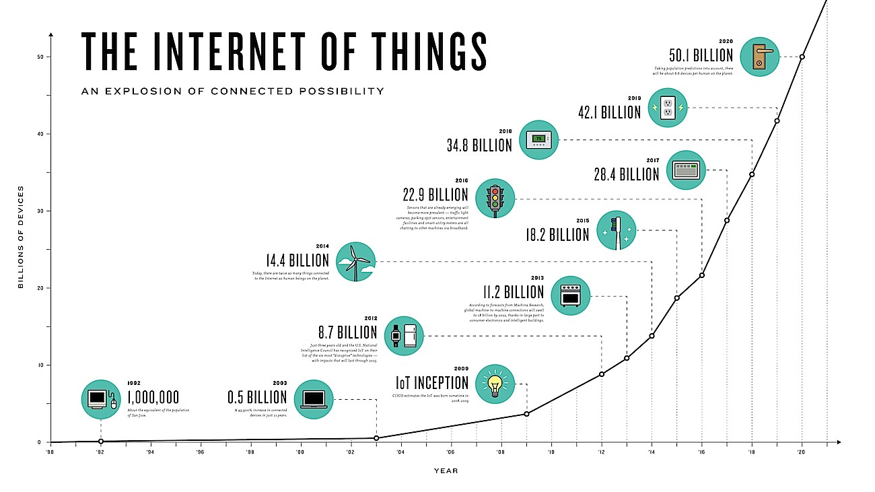
IoT Impact
Growing the number of connected devices to 50 billion in 2020.
* IoT Fundamentals: Networking Technologies, Protocols, and Use Cases for the Internet of Thing, Cisco press, 2017

Slide 21
IoT Impact (cont’d)
Connected roadway (a fully connected transportation infrastructure)
Connected factory
Smart connected building
Smart Creatures
* IoT Fundamentals: Networking Technologies, Protocols, and Use Cases for the Internet of Thing, Cisco press, 2017
Notes:
Connected Roadways
People have been fantasizing about the self-driving car, or autonomous vehicle, in literature and film for decades. While this fantasy is now becoming a reality with well-known projects like Google’s self-driving car, IoT is also a necessary component for implementing a fully connected transportation infrastructure. IoT is going to allow self-driving vehicles to better interact with the transportation system around them through bidirectional data exchanges while also providing important data to the riders. Self-driving vehicles need always on, reliable communications and data from other transportation-related sensors to reach their full potential. Connected roadways is the term associated with both the driver and driverless cars fully integrating with the surrounding transportation infrastructure.
Connected Factory
The main challenges facing manufacturing in a factory environment today include the following:
Accelerating new product and service introductions to meet customer and market opportunities
Increasing plant production, quality, and uptime while decreasing cost
Mitigating unplanned downtime (which wastes, on average, at least 5% of production)
Securing factories from cyber threats
Decreasing high cabling and re-cabling costs (up to 60% of deployment costs)
Improving worker productivity and safety
Industrial enterprises around the world are retooling their factories with advanced technologies and architectures to resolve these problems and boost manufacturing flexibility and speed. These improvements help them achieve new levels of overall equipment effectiveness, supply chain responsiveness, and customer satisfaction. A convergence of factory-based operational technologies and architectures with global IT networks is starting to occur, and this is referred to as the connected factory.
As with the IoT solutions for the connected roadways previously discussed, there are already large numbers of basic sensors on factory floors. However, with IoT, these sensors not only become more advanced but also attain a new level of connectivity. They are smarter and gain the ability to communicate, mainly using the Internet Protocol (IP) over an Ethernet infrastructure.
In addition to sensors, the devices on the plant floor are becoming smarter in their ability to transmit and receive large quantities of real-time informational
and diagnostic data. Ethernet connectivity is becoming pervasive and spreading beyond just the main controllers in a factory to devices such as the robots on the plant floor. In addition, more IP-enabled devices, including video cameras, diagnostic smart objects, and even personal mobile devices, are being added to the manufacturing environment.
Smart Connected Buildings
Another place IoT is making a disruptive impact is in the smart connected buildings space. In the past several decades, buildings have become increasingly complex, with systems overlaid one upon another, resulting in complex intersections of structural, mechanical, electrical, and IT components. Over time, these operational networks that support the building environment have matured into sophisticated systems; however, for the most part, they are deployed and managed as separate systems that have little to no interaction with each other.
Smart Creatures
When you think about IoT, you probably picture only inanimate objects and machines being connected. However, IoT also provides the ability to connect
living things to the Internet. Sensors can be placed on animals and even insects just as easily as on machines, and the benefits can be just as impressive.
One of the most well-known applications of IoT with respect to animals focuses on what is often referred to as the “connected cow.” Sparked, a Dutch company, developed a sensor that is placed in a cow’s ear. The sensor monitors various health aspects of the cow as well as its location and transmits the data wirelessly for analysis by the farmer.

Slide 22
Contents
Basic Concepts and History
Ecosystem
Things
Platform
Networks
Applications and Verticals
Architecture
Challenges
Business and Market Opportunities
Products
Trends

Slide 23
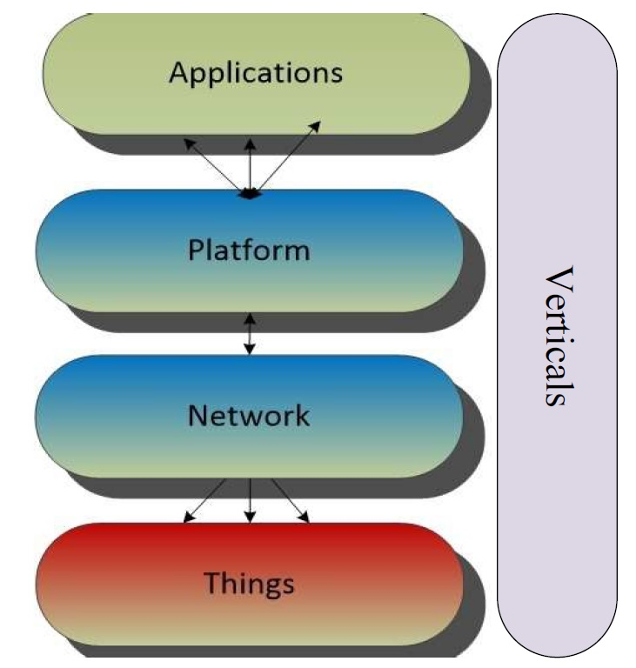
IoT Ecosystem
Things: sensors and actuators
Network: communication technologies
Platform: security, process modeling and device management, data stream and information management, integration of information access mechanisms
Applications: making decisions, big data analytics

Slide 24
Contents
Basic Concepts and History
Ecosystem
Things
Platform
Networks
Applications and Verticals
Architecture
Challenges
Business and Market Opportunities
Products
Trends

Slide 25
What are Things?
A thing is a physical object in which a processor, data storage system, sensor system, and network technology are embedded.
Some things can also affect their environment by means of actuators.
Most things have a user interface and interaction capabilities to communicate with the environment or other devices.
The capability of things to communicate with other things and with their environment is a core component of IoT.
* Internet of Things A to Z : Technologies and Applications, IEEE Press, 2018

Slide 26
What are Things?
Smart objects or Things are any physical objects that contain embedded technology to sense and/or interact with their environment in a meaningful way by being interconnected and enabling communication among themselves or an external agent.
Things are
Sensors
Actuators
* IoT Fundamentals: Networking Technologies, Protocols, and Use Cases for the Internet of Thing, Cisco press, 2017

Slide 27
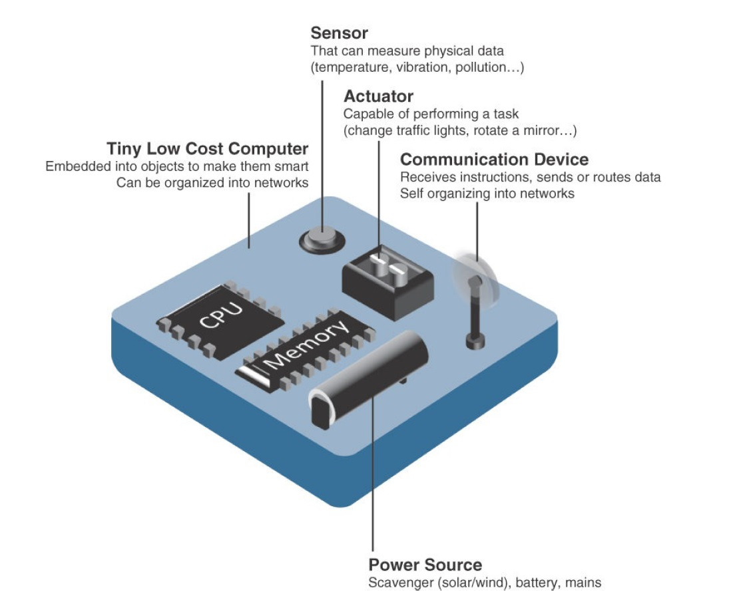
What are Things?
* IoT Fundamentals: Networking Technologies, Protocols, and Use Cases for the Internet of Thing, Cisco press, 2017
Notes:
A smart object is a device that has, at a minimum, the following four defining characteristics :
Processing unit: A smart object has some type of processing unit for acquiring data, processing and analyzing sensing information received by the sensor(s), coordinating control signals to any actuators, and controlling a variety of functions on the smart object, including the communication and power systems. The specific type of processing unit that is used can vary greatly, depending on the specific processing needs of different applications. The most common is a microcontroller because of its small form factor, flexibility, programming simplicity, ubiquity, low power consumption, and low cost.
Sensor(s) and/or actuator(s): A smart object is capable of interacting with the physical world through sensors and actuators. A sensor learns and measures its environment, whereas an actuator is able to produce some change in the physical world. A smart object does not need to contain both sensors and actuators. In fact, a smart object can contain one or multiple sensors and/or actuators, depending upon the application.
Communication device: The communication unit is responsible for connecting a smart object with other smart objects and the outside world (via the network). Communication devices for smart objects can be either wired or wireless. Overwhelmingly, in IoT networks smart objects are wirelessly interconnected for a number of reasons, including cost, limited infrastructure availability, and ease of deployment. There are myriad different communication protocols for smart objects.
Power source: Smart objects have components that need to be powered. Interestingly, the most significant power consumption usually comes from the communication unit of a smart object. As with the other three smart object building blocks, the power requirements also vary greatly from application to application. Typically, smart objects are limited in power, are deployed for a very long time, and are not easily accessible. This combination, especially when the smart object relies on battery power, implies that power efficiency, judicious power management, sleep modes, ultra-low power consumption hardware, and so on are critical design elements. For long-term deployments where smart objects are, for all practical purposes, inaccessible, power is commonly obtained from scavenger sources (solar, piezoelectric, and so on) or is obtained in a hybridized manner, also tapping into infrastructure power.

Slide 28
What are Things?
Sensors
A sensor measures some physical quantity and converts it into a digital representation.
That digital representation is typically passed to another device for transformation into useful data that can be consumed by intelligent devices or humans.
Sensors can be readily embedded in any physical objects that are easily connected to the Internet by wired or wireless networks.
Because these connected host physical objects with multidimensional sensing capabilities communicate with each other and external systems, they can interpret their environment and make intelligent decisions.
Actuators
* IoT Fundamentals: Networking Technologies, Protocols, and Use Cases for the Internet of Thing, Cisco press, 2017
Notes:
Sensors
A sensor measures some physical quantity and converts that measurement reading into a digital representation.
That digital representation is typically passed to another device for transformation into useful data that can be consumed by intelligent devices or humans.
Sensors can be readily embedded in any physical objects that are easily connected to the Internet by wired or wireless networks.
Because these connected host physical objects with multidimensional sensing capabilities communicate with each other and external systems, they can interpret their environment and make intelligent decisions.

Slide 29
What are Things?
Sensors
Different types of sensors
Active or passive
Invasive or non-invasive
Contact or no-contact
Absolute or relative
Area of application
How sensors measure
What sensors measure
Actuators
* IoT Fundamentals: Networking Technologies, Protocols, and Use Cases for the Internet of Thing, Cisco press, 2017
Notes:
Sensors
Different types of sensors
Active or passive: Sensors can be categorized based on whether they produce an energy output and typically require an external power supply (active) or whether they simply receive energy and typically require no external power supply (passive).
Invasive or non-invasive: Sensors can be categorized based on whether a sensor is part of the environment it is measuring (invasive) or external to it (non-invasive).
Contact or no-contact: Sensors can be categorized based on whether they require physical contact with what they are measuring (contact) or not (no-contact).
Absolute or relative: Sensors can be categorized based on whether they measure on an absolute scale (absolute) or based on a difference with a fixed or variable reference value (relative).
Area of application: Sensors can be categorized based on the specific industry or vertical where they are being used.
How sensors measure: Sensors can be categorized based on the physical mechanism used to measure sensory input (for example, thermoelectric, electrochemical, piezoresistive, optic, electric, fluid mechanic, photoelastic).
What sensors measure: Sensors can be categorized based on their applications or what physical variables they measure.

Slide 30
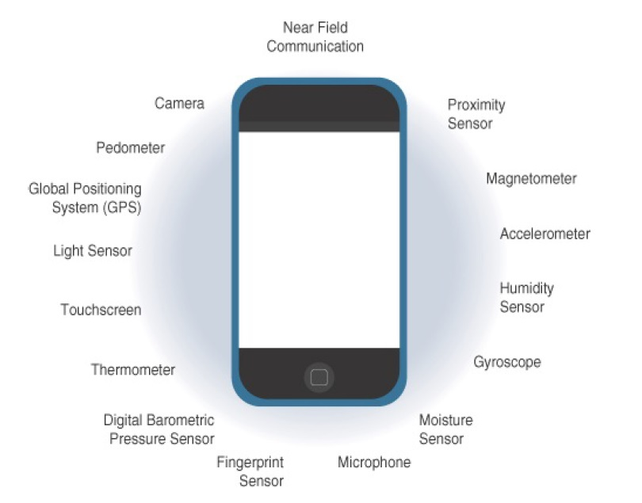
What are Things?
Sensors in smart phones
* IoT Fundamentals: Networking Technologies, Protocols, and Use Cases for the Internet of Thing, Cisco press, 2017

Slide 31
What are Things?
Sensors
Actuators
Actuators receive some type of control signal (commonly an electric signal or digital command) that triggers a physical effect, usually some type of motion, force, and so on.
* IoT Fundamentals: Networking Technologies, Protocols, and Use Cases for the Internet of Thing, Cisco press, 2017

Slide 32
What are Things?
Sensors
Actuators
Different types of actuators
Type of motion
Power
Binary or continuous
Area of application
Type of energy
* IoT Fundamentals: Networking Technologies, Protocols, and Use Cases for the Internet of Thing, Cisco press, 2017
Notes:
Actuators
Different types of actuators
Type of motion: Actuators can be classified based on the type of motion they produce (for example, linear, rotary, one/two/three-axes).
Power: Actuators can be classified based on their power output (for example, high power, low power, micro power)
Binary or continuous: Actuators can be classified based on the number of stable-state outputs.
Area of application: Actuators can be classified based on the specific industry or vertical where they are used.
Type of energy: Actuators can be classified based on their energy type.

Slide 33
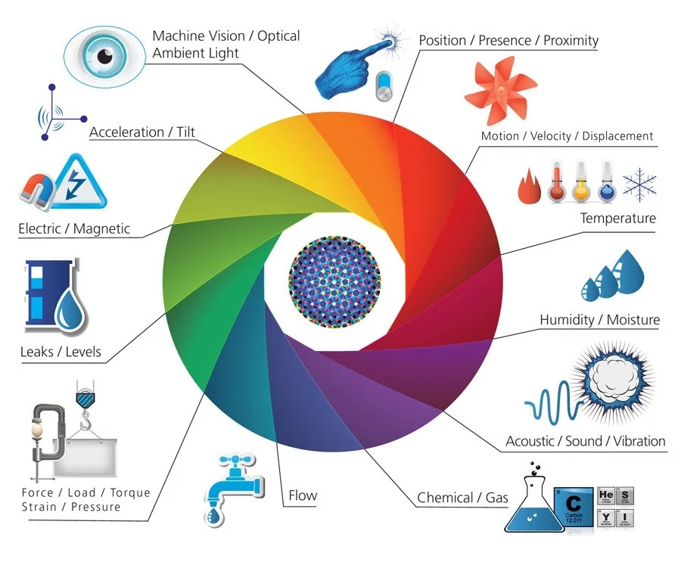
What are Things?
Sensors and Actuators
* https://www.postscapes.com/iot-sensors-actuators

Slide 34
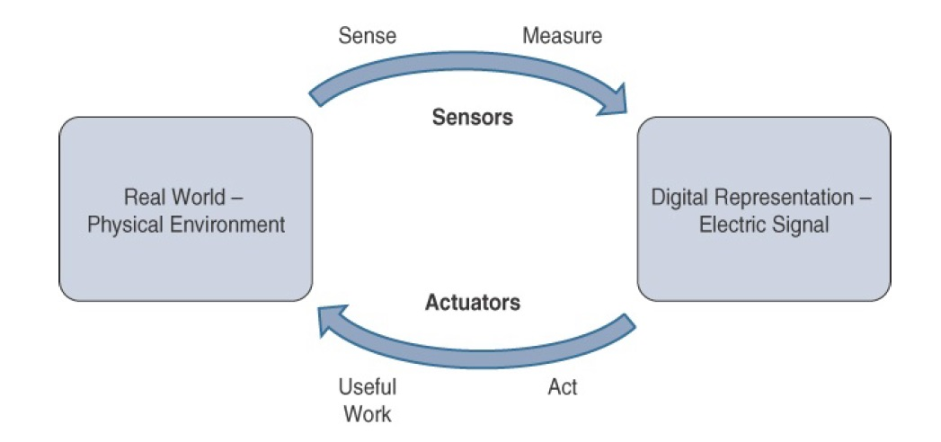
What are Things?
How Sensors and Actuators Interact with the Physical World
* IoT Fundamentals: Networking Technologies, Protocols, and Use Cases for the Internet of Thing, Cisco press, 2017
Notes:
Sensors are designed to sense and measure practically any measurable variable in the physical world. They convert their measurements (typically analog) into electric signals or digital representations that can be consumed by an intelligent agent (a device or a human).
Actuators, on the others hand, receive some type of control signal (commonly an electric signal or digital command) that triggers a physical effect, usually some type of motion, force, and so on.

Slide 35
What is Smart environment?
A smart environment is the physical world that is richly and invisibly interwoven with sensors, actuators, displays, and computational elements, embedded seamlessly in the every day objects of our lives, and connected through a continuous network.
* Internet of Things A to Z : Technologies and Applications, IEEE Press, 2018

Slide 36
Contents
Basic Concepts and History
Ecosystem
Things
Platform
Networks
Applications and Verticals
Architecture
Challenges
Business and Market Opportunities
Products
Trends

Slide 37
IoT Platforms
IoT platforms are the central piece in the Internet of Things architecture that connect the real and the virtual worlds and enable communication between objects.
In its most simple form, an IoT platform is just about enabling connectivity between objects.
In a more sophisticated form, the platform consists of a variety of important building blocks:
Connectivity and normalization,
device management,
database,
processing and action management,
analytics,
visualization,
additional tools, and
external interfaces
* IoT Platforms, IoT Analytics, 2015
Notes:
CONNECTIVITY and NORMALIZATION
Every IoT platform starts with a connectivity layer. It has the function of bringing different protocols and different data formats into one “software” interface. This is necessary in order to ensure all devices can be interacted with and data is read correctly. Having all device data in one place and in one format is the basic necessity to monitor, manage, and analyze IoT devices. What sounds fairly simple can be a nightmare from the point of view of a computer engineer. Libraries need to be set up for individual devices so that something as basic as an industrial pressure sensor that sends analogue signals can be integrated into the platform for one use case while a wearable device or the data from someone’s smartphone can be integrated for another use case. Advanced devices usually provide an API that allows for a standardized communication interface to the platform. However, very often so-called software agents have to be developed and installed on the hardware in order to enable the IoT platform to establish a stable connection.
2. DEVICE MANAGEMENT
The device management module of an IoT platform ensures the connected objects are working properly and its software and applications are updated and running. Tasks performed in this module include device provisioning, remote configuration, management of firmware/ software updates, and troubleshooting. As thousands or even millions of different devices become part of an IoT enabled solution, bulk-actions, and automation are essential to control costs and reduce manual labor.
3. DATABASE
Data storage is a central piece in an IoT platform. The management of device data brings the requirements for databases to a new level:
• Volume. The amount of data that needs to be stored can be massive. In many IoT solutions only the minority of the generated data can be stored.
• Variety. Different devices and different sensor types produce very different forms of data.
• Velocity. Many IoT cases require the analysis of streaming data to make instant decisions.
• Veracity. In some instances, sensors produce ambiguous and inaccurate data. An IoT platform therefore usually comes with a cloud based database solution that is distributed across different sensor nodes. It should be scalable for big data and should be able to store both structured (SQL) and unstructured data (NoSQL).
4. PROCESSING & ACTION MANAGEMENT
The data that is captured in the connectivity & normalization module and that is stored in the database gets brought to life in this part of the IoT platform. A rule-based event-action-trigger allows performance of “smart” actions based on specific sensor data. In a smart home, for instance, an event-action-trigger can be defined so that all lights get turned off when a person leaves the house. The technical realization often comes in the form of an If-this-then-that rule (IFTTT): If the GPS signal indicates Jason’s smartphone is more than 5 yards away from his house, then turn off all the lights in his house.
5. ANALYTICS
Many IoT use cases go beyond action-management and require complex analytics to get the most out of the IoT data-stream. In a smart home, for example, the analytics engine can provide the algorithms that allow the IoT platform to learn which combination of lights and heating are preferred by the user at what time of the day and in relation to the outside weather conditions..The analytics engine encompasses all dynamic calculations of sensor data, from basic data clustering to deep machine learning.
6. DATA VISUALIZATION
Sometimes also referred to as “visual analytics,” data visualization presents a much-underrated part of the IoT platform. The combination of human eye and brain is still far superior to most analytic and rule-based engines. That is why data visualization is so important: it enables humans to see patterns and observe trends. Visualization comes in the form of line-, stacked-, or pie charts, 2D- or even 3D-models. The visualization dashboard that is available to the manager of the IoT platform is often also included in the prototyping tools that an advanced IoT platform provides.
7. ADDITIONAL TOOLS
Advanced IoT platforms often offer an additional set of tools for the developer and the manager of the IoT solution. Development tools allow the IoT developer to prototype and test the IoT case. Sometimes even in the form of what-you-see-is-what-you-get-editors (WYSIWYG) that lets you create simple smartphone apps for visualizing and controlling connected devices. Management-focused tools support the daily operations of the IoT solution. An example is an „access management“ tool that determines who has access to which device and to which data. Another tool is “reporting”, that allows for data export (e.g., in a.csv or.json format) as well as data queries and other forms of structured output.
8. EXTERNAL INTERFACES
IoT enabled businesses are rarely built standalone and on a green field. In established companies it is crucial that the Internet of Things integrates with existing ERP systems, management tools, manufacturing execution systems and the rest of the wider IT-ecosystem.

Slide 38
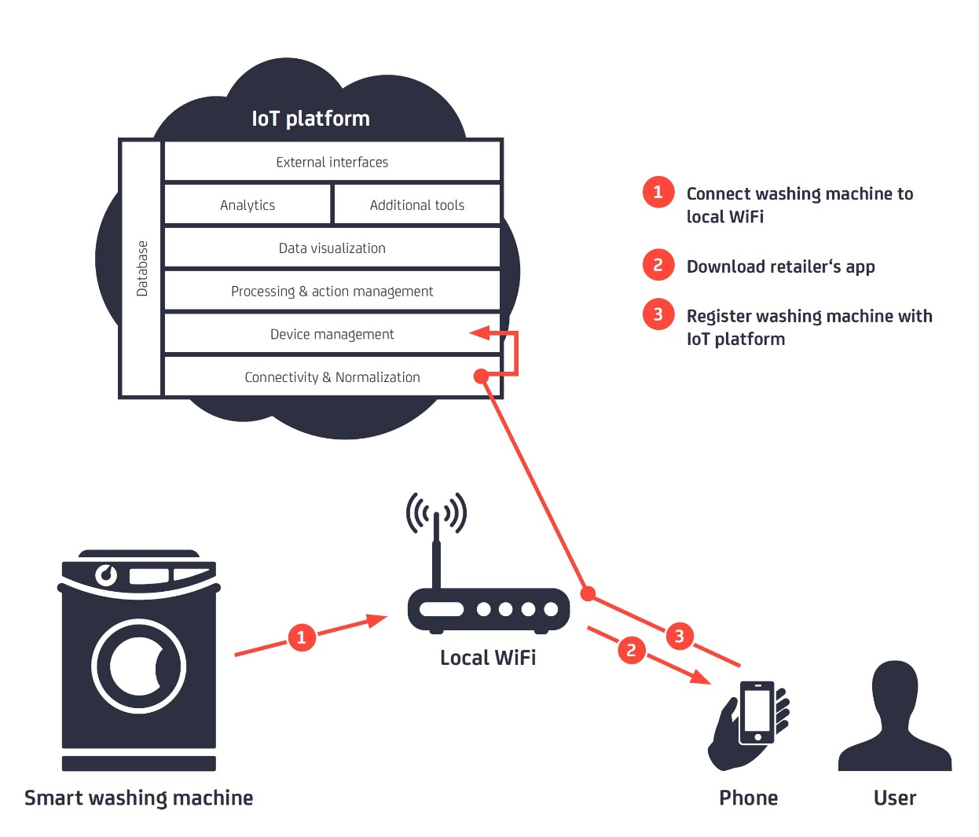
IoT Platforms
* IoT Platforms, IoT Analytics, 2015

Slide 39
IoT Platforms
An IoT platform is an end-to-end software framework.
It's the glue that pulls together information from sensors, devices, networks, and software that work together to unlock valuable, actionable data.
A platform should have the ability to:
manage devices
allow remote connections to all relevant objects or devices
collect and manage data and help you define business rules
enable analytics and visualization
integrate with IT and cloud services
* https://www.business.att.com/learn/research-reports/whats-an-iot-platform-and-what-role-does-it-play.html

Slide 40
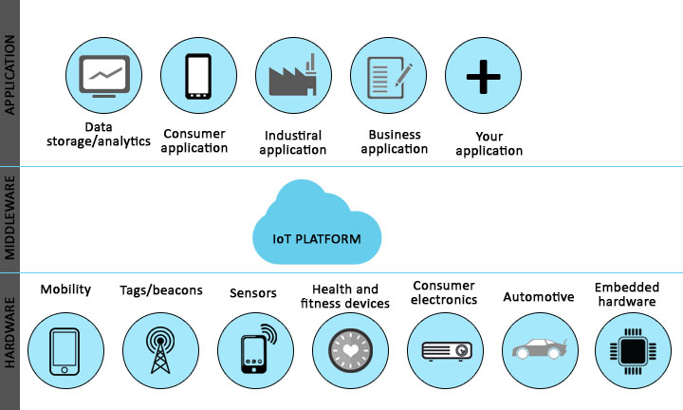
IoT Platforms
* https://www.educba.com/iot-platform/

Slide 41
Contents
Basic Concepts and History
Ecosystem
Things
Platform
Networks
Applications and Verticals
Architecture
Challenges
Business and Market Opportunities
Products
Trends

Slide 42
IoT Networks
IoT Network is the communication domain for the IoT devices and endpoints.
It includes the devices themselves and the communications network that links them.
Embodiments of this communications infrastructure include wireless mesh technologies, such as IEEE 802.15.4, and wireless point-to-multipoint systems, such as IEEE 801.11ah.
Also, included are wired device connections, such as IEEE 1901 power line communications.
In many cases, the smart (and sometimes not-so-smart) devices communicate with each other. In other cases, machine-to-machine communication is not necessary, and the devices simply communicate through a field area network (FAN) to use-case-specific apps in the IoT application domain.
Therefore, the device domain also includes the gateway device, which provides communications up into the core network and acts as a demarcation point between the device and network domains.
* IoT Fundamentals: Networking Technologies, Protocols, and Use Cases for the Internet of Thing, Cisco press, 2017

Slide 43
Contents
Basic Concepts and History
Ecosystem
Things
Platform
Networks
Applications and Verticals
Architecture
Challenges
Business and Market Opportunities
Products
Trends

Slide 44
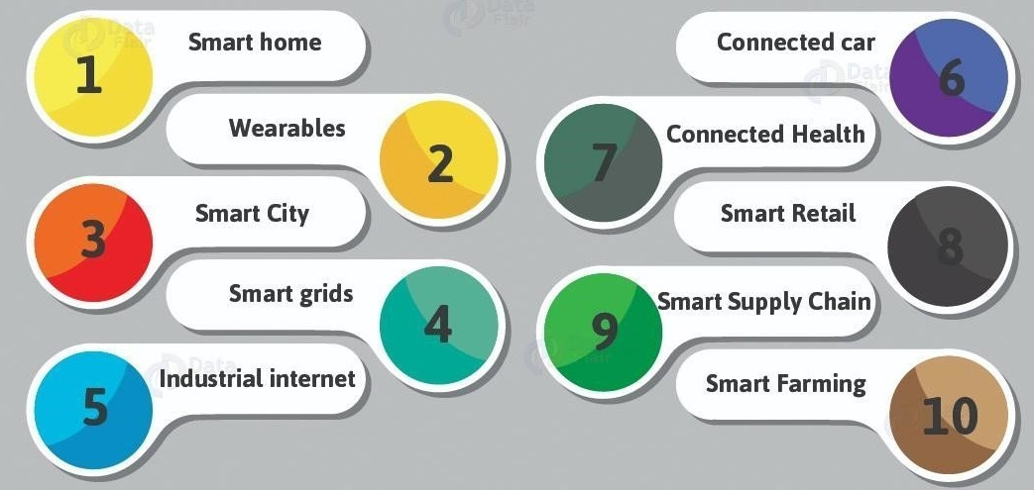
IoT Applications and Verticals
* https://www.meee-services.com/category/artificial-intelligence/

Slide 45
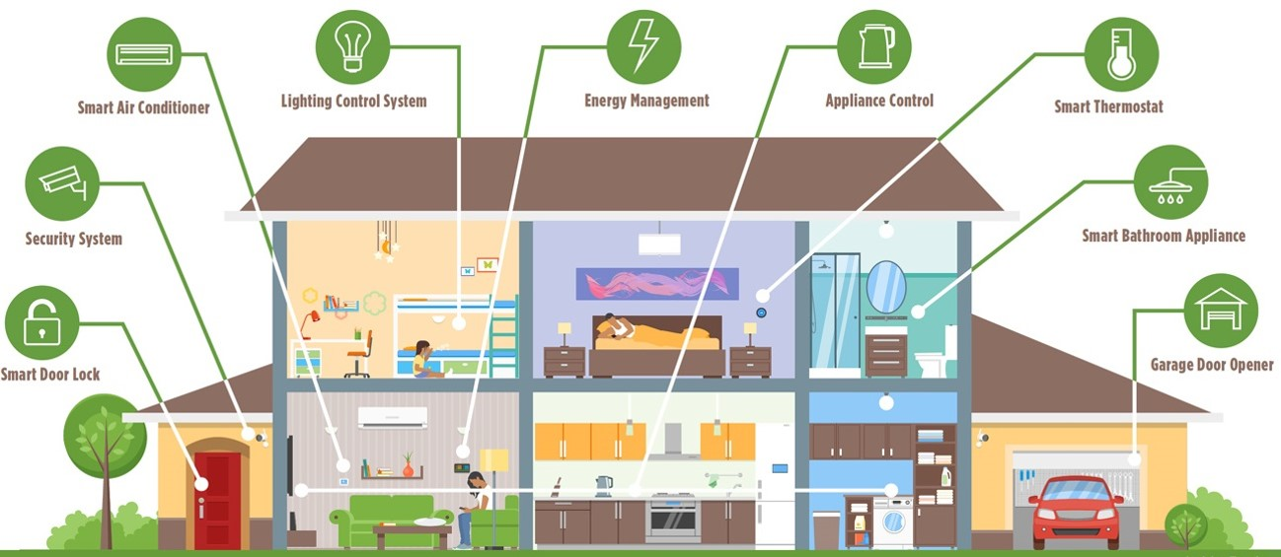
IoT Applications and Verticals- Smart Home
Smart Home
* https://www.bluebonnetelectric.coop/Community/News/articles/2016/Magazine-Stories/HOME,-SMART-HOME-Trends-in-residential-technology

Slide 46
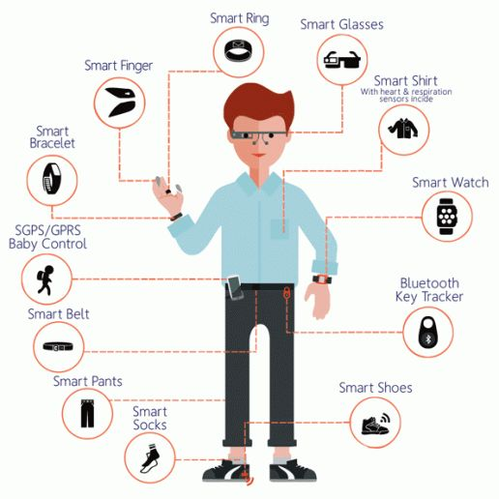
IoT Applications and Verticals- Smart Wearables
* https://www.quora.com/Why-the-boom-of-wearable-devices

Slide 47
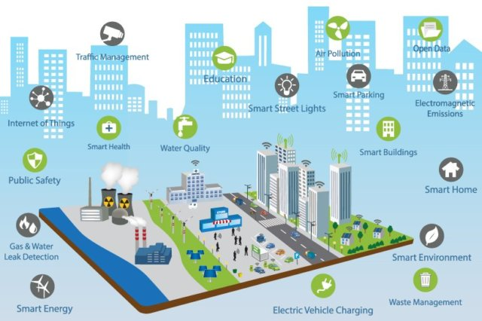
IoT Applications and Verticals- Smart City
Smart City
* https://www.ifpenergiesnouvelles.com/article/smart-city-energy-challenges-facing-sustainable-cities

Slide 48
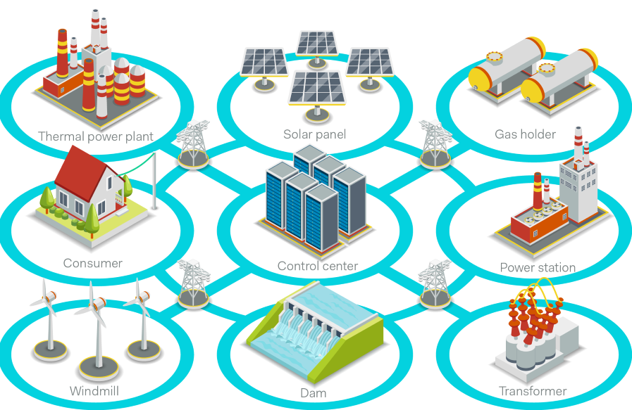
IoT Applications and Verticals- Smart Grid
* https://www.powerelectronicsnews.com/technology/is-your-smart-grid-secured

Slide 49
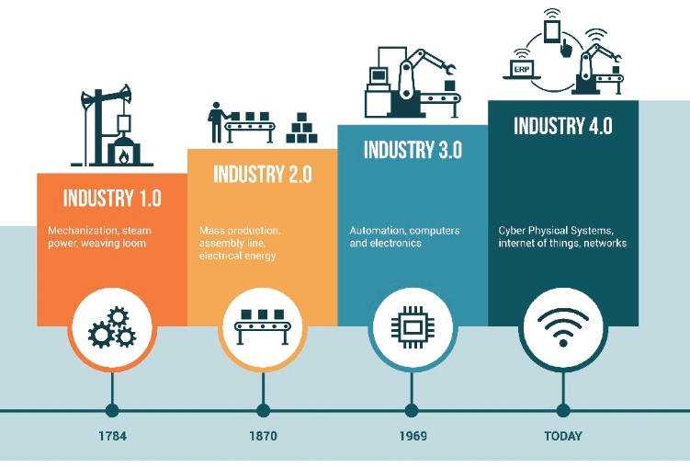
IoT Applications and Verticals- Industrial IoT
* https://www.seekmomentum.com/blog/page/3

Slide 50
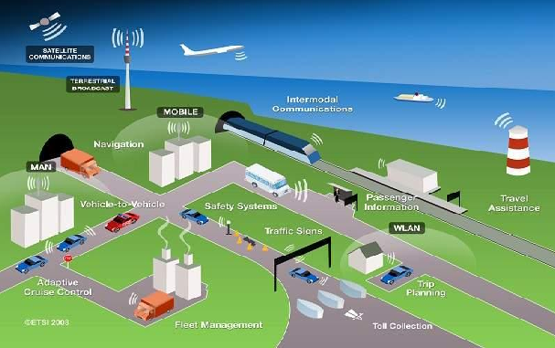
IoT Applications and Verticals- Smart Transportation
* https://www.sentinelassam.com/editorial/intelligent-transportation-system-and-smart-city-4/

Slide 51
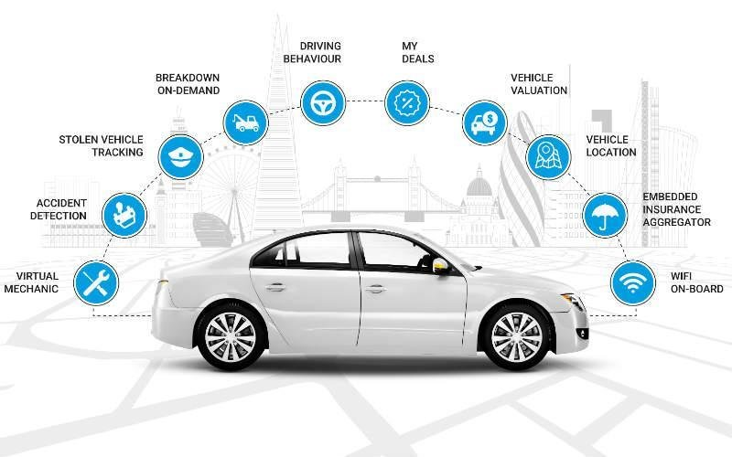
IoT Applications and Verticals- Connected Car
* https://www.researchgate.net/figure/Function-of-connected-car_fig1_323258412

Slide 52
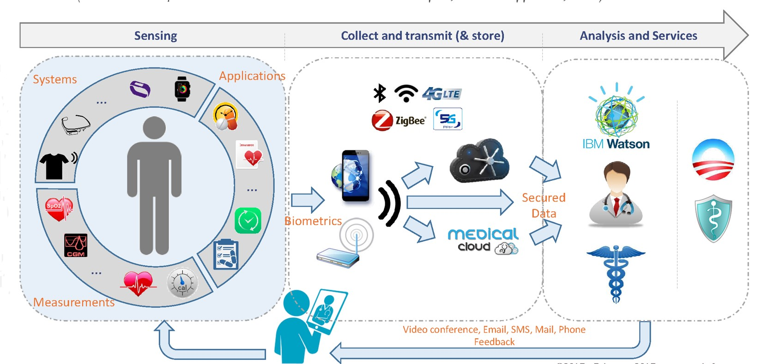
IoT Applications and Verticals- Connected Health
* http://www.yole.fr/IoT_Seminar_Yole_FraunhoferEMFT.aspx

Slide 53
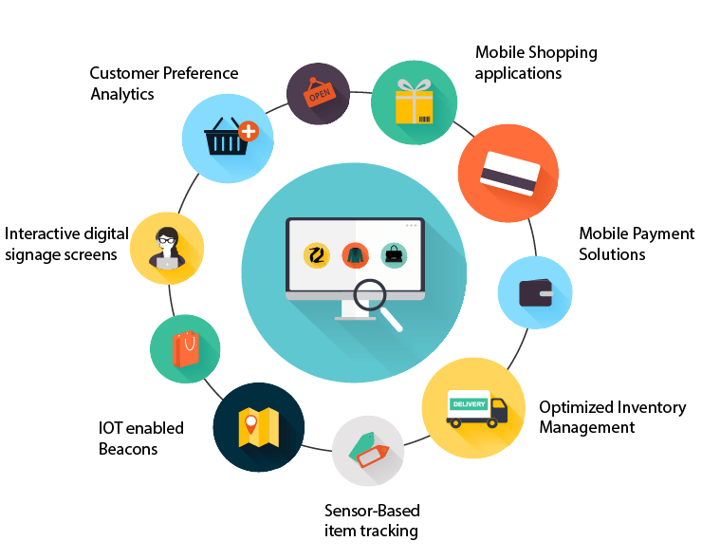
IoT Applications and Verticals- Smart Retail
* https://tmrblog.com/smart-retail-systems-market-iot-influence-the-future-of-retail-store/

Slide 54
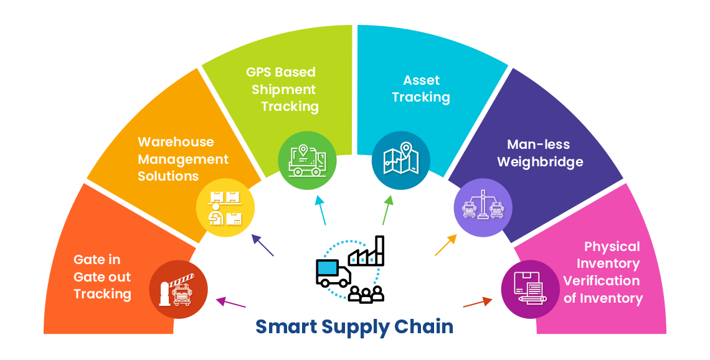
IoT Applications and Verticals- Smart Supply Chain
* https://www.ecubix.com/smart-supply-chain-solutions/

Slide 55
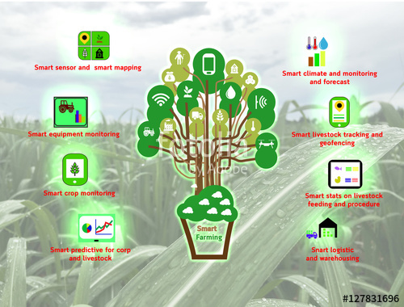
IoT Applications and Verticals- Smart Farming
* https://stock.adobe.com/images

Slide 56
Contents
Basic Concepts and History
Ecosystem
Things
Platform
Networks
Applications and Verticals
Architecture
Challenges
Business and Market Opportunities
Products
Trends

Slide 57
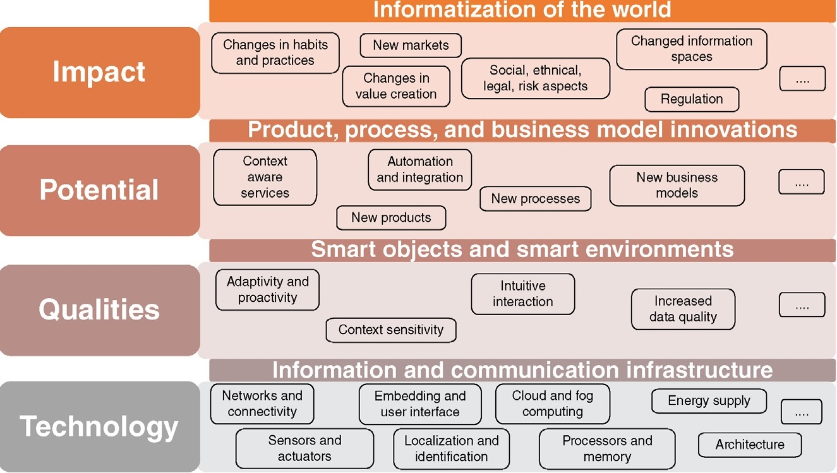
IoT Framework
Layer 1:
modern information and communication technologies form the technical foundation of IoT
* Internet of Things A to Z : Technologies and Applications, IEEE Press, 2018
Notes:
Layer 1:
At the core, modern information and communication technologies form the technical foundation of IoT.
Layer 2:
IoT generates a network of unambiguously identifiable physical objects (things). Networking, and thus also the ability to communicate, does not only refer to human participants but also to the objects (or things) involved.
These things are equipped with miniaturized processors and actuators, for example, mechanical elements, temperature controllers, and audio or video output devices that can be utilized to control the objects and the environment.
This allows for adapting objects and environments to our needs, interacting with the situation, and the provisioning of information and services according to specific situational requirements, that is, they become “smart objects” and “smart environments”.
Layer 3:
The automatic identification via RFID is often regarded as the basis for IoT. Sensors and actuators expand functionality by capturing states and the execution of actions or effects on reality.
This results in potential for new services, including consumer products as well as new business processes and business models.
Layer 4:
Products for consumers, for example, may hold and provide a large amount of information and can also offer customers with additional context-specific services during the post-sales phase.
IoT also provides a higher level of data quality for business processes, enabling organizations to respond more rapidly and properly to events, and may contribute to improved efficiency, accuracy, and economic benefits.
These potentials will lead to various product, process, and business model innovations. As these innovations affect our every day lives, they have a wide impact on individuals, society, markets, and companies.

Slide 58
IoT Framework (cont’d)
Layer 2:
IoT generates a network of unambiguously identifiable physical things.
These things are equipped with miniaturized processors and actuators
This allows for adapting objects and environments to our needs
* Internet of Things A to Z : Technologies and Applications, IEEE Press, 2018
Notes:
Layer 1:
At the core, modern information and communication technologies form the technical foundation of IoT.
Layer 2:
IoT generates a network of unambiguously identifiable physical objects (things). Networking, and thus also the ability to communicate, does not only refer to human participants but also to the objects (or things) involved.
These things are equipped with miniaturized processors and actuators, for example, mechanical elements, temperature controllers, and audio or video output devices that can be utilized to control the objects and the environment.
This allows for adapting objects and environments to our needs, interacting with the situation, and the provisioning of information and services according to specific situational requirements, that is, they become “smart objects” and “smart environments”.
Layer 3:
The automatic identification via RFID is often regarded as the basis for IoT. Sensors and actuators expand functionality by capturing states and the execution of actions or effects on reality.
This results in potential for new services, including consumer products as well as new business processes and business models.
Layer 4:
Products for consumers, for example, may hold and provide a large amount of information and can also offer customers with additional context-specific services during the post-sales phase.
IoT also provides a higher level of data quality for business processes, enabling organizations to respond more rapidly and properly to events, and may contribute to improved efficiency, accuracy, and economic benefits.
These potentials will lead to various product, process, and business model innovations. As these innovations affect our every day lives, they have a wide impact on individuals, society, markets, and companies.

Slide 59
IoT Framework (cont’d)
Layer 3:
Sensors and actuators expand functionality by capturing states and the execution of actions.
This results in potential for new services, including consumer products as well as new business processes and business models.
* Internet of Things A to Z : Technologies and Applications, IEEE Press, 2018
Notes:
Layer 1:
At the core, modern information and communication technologies form the technical foundation of IoT.
Layer 2:
IoT generates a network of unambiguously identifiable physical objects (things). Networking, and thus also the ability to communicate, does not only refer to human participants but also to the objects (or things) involved.
These things are equipped with miniaturized processors and actuators, for example, mechanical elements, temperature controllers, and audio or video output devices that can be utilized to control the objects and the environment.
This allows for adapting objects and environments to our needs, interacting with the situation, and the provisioning of information and services according to specific situational requirements, that is, they become “smart objects” and “smart environments”.
Layer 3:
The automatic identification via RFID is often regarded as the basis for IoT. Sensors and actuators expand functionality by capturing states and the execution of actions or effects on reality.
This results in potential for new services, including consumer products as well as new business processes and business models.
Layer 4:
Products for consumers, for example, may hold and provide a large amount of information and can also offer customers with additional context-specific services during the post-sales phase.
IoT also provides a higher level of data quality for business processes, enabling organizations to respond more rapidly and properly to events, and may contribute to improved efficiency, accuracy, and economic benefits.
These potentials will lead to various product, process, and business model innovations. As these innovations affect our every day lives, they have a wide impact on individuals, society, markets, and companies.

Slide 60
IoT Framework (cont’d)
Layer 4:
IoT provides a higher level of data quality for business processes, enabling organizations to respond more rapidly, and may contribute to improved efficiency, accuracy, and economic benefits.
These potentials will lead to various product, process, and business model innovations.
* Internet of Things A to Z : Technologies and Applications, IEEE Press, 2018
Notes:
Layer 1:
At the core, modern information and communication technologies form the technical foundation of IoT.
Layer 2:
IoT generates a network of unambiguously identifiable physical objects (things). Networking, and thus also the ability to communicate, does not only refer to human participants but also to the objects (or things) involved.
These things are equipped with miniaturized processors and actuators, for example, mechanical elements, temperature controllers, and audio or video output devices that can be utilized to control the objects and the environment.
This allows for adapting objects and environments to our needs, interacting with the situation, and the provisioning of information and services according to specific situational requirements, that is, they become “smart objects” and “smart environments”.
Layer 3:
The automatic identification via RFID is often regarded as the basis for IoT. Sensors and actuators expand functionality by capturing states and the execution of actions or effects on reality.
This results in potential for new services, including consumer products as well as new business processes and business models.
Layer 4:
Products for consumers, for example, may hold and provide a large amount of information and can also offer customers with additional context-specific services during the post-sales phase.
IoT also provides a higher level of data quality for business processes, enabling organizations to respond more rapidly and properly to events, and may contribute to improved efficiency, accuracy, and economic benefits.
These potentials will lead to various product, process, and business model innovations. As these innovations affect our every day lives, they have a wide impact on individuals, society, markets, and companies.

Slide 61
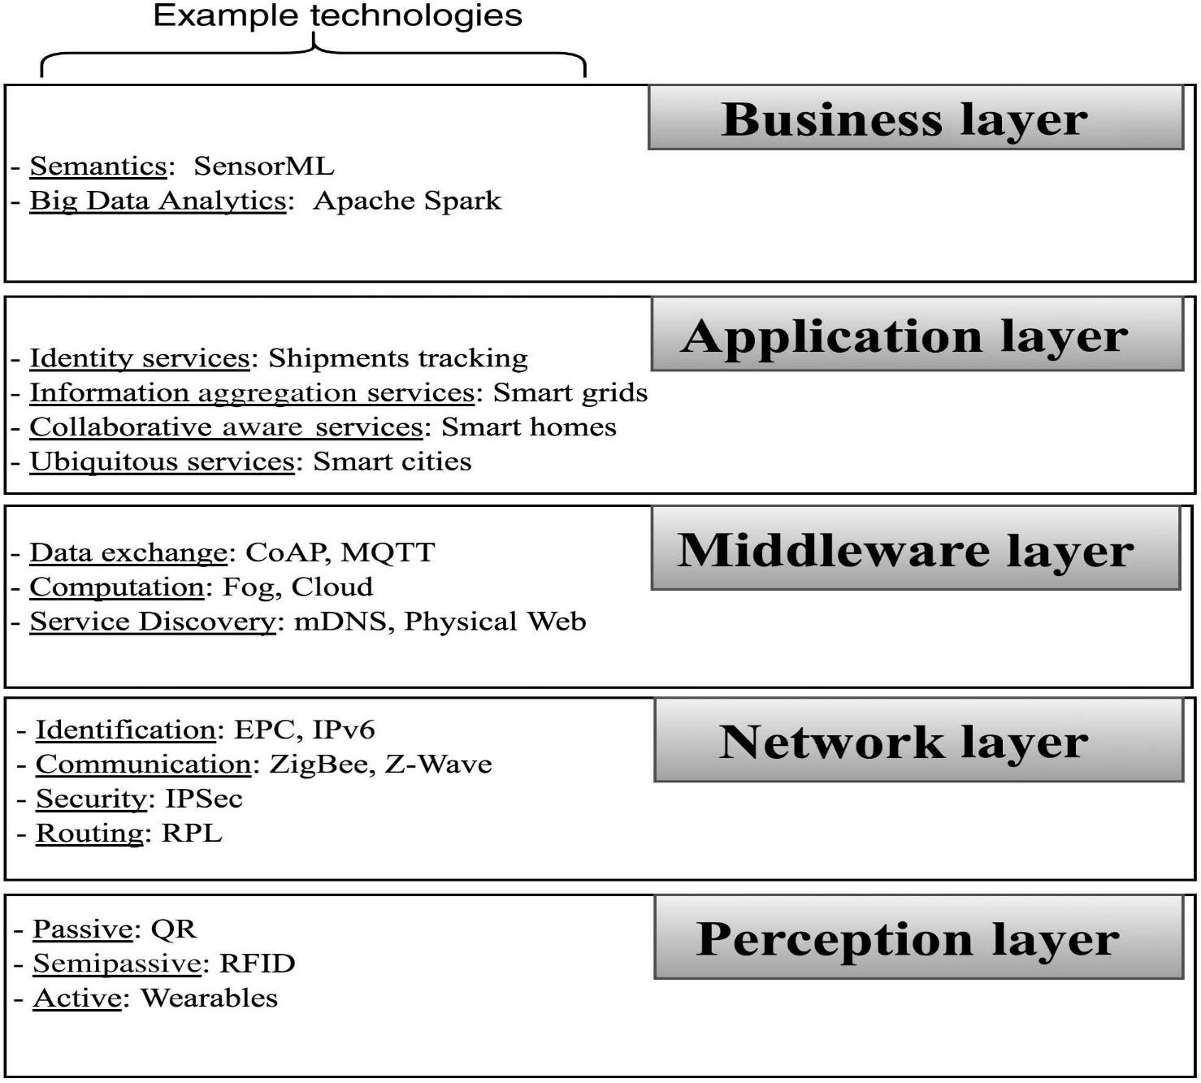
IoT Architecture
Perception or Object Layer
It includes various types of physical devices that are responsible for collecting data and acting accordingly, such as object identifiers, temperatures, locations, and humidity measurements.
The power consumption and communication ability (i.e., unidirectional or bidirectional) are important aspects of this layer.
* Internet of Things A to Z : Technologies and Applications, IEEE Press, 2018
Notes:
Perception Layer
The perception layer (also known as the objects layer) is the first layer in the IoT model. It includes various types of physical devices that are responsible for collecting data and acting accordingly, such as object identifiers, temperatures, locations, and humidity measurements.
The power consumption and communication ability (i.e., unidirectional or bidirectional) are important aspects of this layer.

Slide 62
IoT Architecture (cont’d)
Network or Abstraction Layer
This layer technologies transform the conventional sensors described in the perception layer into smart and connected nodes.
Network layer technologies enable nodes to be identifiable over the Internet or any local area network, which allows them to securely communicate with each other.
* Internet of Things A to Z : Technologies and Applications, IEEE Press, 2018
Notes:
Network Layer
The network or object abstraction layer is the second layer. It is considered the infrastructure layer because its technologies transform the conventional sensors described in the perception layer into smart and connected nodes.
Network layer technologies enable nodes to be identifiable over the Internet or any local area network, which allows them to securely communicate with each other.
Many technologies in this layer are also found in the first three layers in the IP suite (TCP/IP) (i.e., Link, Internet, and Transport layers).
Due to the restricted capabilities (i.e., power and computing) of most IoT nodes, scalable and efficient routing techniques are required to ensure interoperability among IoT devices.
Note that many of IoT technologies are actually utilized in WSNs or machine-to-machine (M2M) communications but were improved to meet IoT requirements (i.e., Internet connectivity). Many modern devices use more than one technology; as in smart watches, which often have Wi-Fi, Bluetooth, and NFC.

Slide 63
IoT Architecture (cont’d)
Middleware or Service management Layer
Technologies in this layer are often supported by IoT platforms
This layer enables services to be identified and requested based on names and addresses
This layer enables programmers to interact with heterogeneous objects, regardless of the specific hardware setup.
This layer also processes received data, makes decisions, and delivers required services.
* Internet of Things A to Z : Technologies and Applications, IEEE Press, 2018
Notes:
Middleware or Service management Layer
The middle ware layer (also known as the service management layer) is the core of the IoT environment. It can be mapped to the application layer in the IP suite (TCP/IP).
Technologies in this layer are often supported by IoT platforms. This layer enables services to be identified and requested based on names and addresses and enables programmers to interact with heterogeneous objects, regardless of the specific hardware setup. This layer also processes received data, makes decisions, and delivers required services.

Slide 64
IoT Architecture (cont’d)
Application Layer
This layer is responsible for providing requested services to IoT users via a simple interface without knowing how service requests are processed in the underlying layers.
IoT users can access a service (e.g., reading or setting temperature conditions remotely or tracking and managing vehicles) using many platforms (e.g., laptops, smartphones, and smart watches) via web portals or applications.
* Internet of Things A to Z : Technologies and Applications, IEEE Press, 2018
Notes:
Application Layer
This layer is responsible for providing requested services to IoT users via a simple interface without knowing how service requests are processed in the underlying layers. IoT users can access a service (e.g., reading or setting temperature conditions remotely or tracking and managing vehicles) using many platforms (e.g., laptops, smartphones, and smart watches) via web portals or applications.

Slide 65
IoT Architecture (cont’d)
Business Layer
In this layer, service data and IoT environmental data, such as business models, flowcharts, and graphs, can be accessed.
This access helps administrators in the design, analysis, implementation, evaluation, monitoring, and development of IoT systems because the output of each of the previously mentioned layers is analyzed in this layer to improve services and protect user privacy.
* Internet of Things A to Z : Technologies and Applications, IEEE Press, 2018
Notes:
Business Layer
In this layer, unlike the application layer, service data and IoT environmental data, such as business models, flowcharts, and graphs, can be accessed.
This access helps administrators in the design, analysis, implementation, evaluation, monitoring, and development of IoT systems because the output of each of the previously mentioned layers is analyzed in this layer to improve services and protect user privacy

Slide 66
Contents
Basic Concepts and History
Ecosystem
Things
Platform
Networks
Applications and Verticals
Architecture
Challenges
Business and Market Opportunities
Products
Trends

Slide 67
IoT Challenges
Scalability
Security
Privacy
Big Data and Data Analytics
Interoperability
* IoT Fundamentals: Networking Technologies, Protocols, and Use Cases for the Internet of Thing, Cisco press, 2017

Slide 68
IoT Challenges (cont’d)
Scalability
The IPv4 address space has reached exhaustion and is unable to meet IoT’s scalability requirements.
For IoT scale can be met only by IPv6.
Security
Privacy
Big Data and Data Analytics
Interoperability
* IoT Fundamentals: Networking Technologies, Protocols, and Use Cases for the Internet of Thing, Cisco press, 2017

Slide 69
IoT Challenges (cont’d)
Scalability
Security
With more “things” connected with other “things” and people security is an increasingly complex issue for IoT.
Threat surface is greatly expanded and if device gets hacked, its connectivity is a major concern.
A Compromised device can serve as a launching point to attack other devices and systems.
Privacy
Big Data and Data Analytics
Interoperability
* IoT Fundamentals: Networking Technologies, Protocols, and Use Cases for the Internet of Thing, Cisco press, 2017

Slide 70
IoT Challenges (cont’d)
Scalability
Security
Privacy
A sensor become more prolific in every day lives, the data what they gather will be specific to individuals and their activities.
For Businesses, the data has monetary value.
Organization discusses about who owns the data and how individuals can control whether it is shared and with whom.
Big Data and Data Analytics
Interoperability
* IoT Fundamentals: Networking Technologies, Protocols, and Use Cases for the Internet of Thing, Cisco press, 2017

Slide 71
IoT Challenges (cont’d)
Scalability
Security
Privacy
Big Data and Data Analytics
IoT and large number of sensors are going to trigger deluge of data that must be handled.
This data will provide critical information and insights if it can be processed in an efficient manner.
Challenge is evaluating massive amounts of data arriving from different sources in various forms and doing so in a timely manner.
Interoperability
* IoT Fundamentals: Networking Technologies, Protocols, and Use Cases for the Internet of Thing, Cisco press, 2017

Slide 72
IoT Challenges (cont’d)
Scalability
Security
Privacy
Big Data and Data Analytics
Interoperability
As with nascent technology, various protocols and architectures are jockeying for market share and standardizations within IoT.
Some of these protocols and architectures are based on proprietary elements and others are open.
Recently IoT Standards are helping minimize this problem, but there are often various protocols and implementations available for IoT networks.
* IoT Fundamentals: Networking Technologies, Protocols, and Use Cases for the Internet of Thing, Cisco press, 2017

Slide 73
IoT Enabling Technologies
Perception Layer:
Passive technologies
Semi passive technologies
Active technologies
Network Layer:
Identification
Communication
Security
Routing
Middleware Layer:
Service Discovery
Data Exchange
Computation
Application Layer:
identity-Related Services
Information Aggregation Services
Collaborative Aware Services
Ubiquitous Services
Business Layer:
Semantics
Big Data Analytics
* Internet of Things A to Z : Technologies and Applications, IEEE Press, 2018

Slide 74
IoT Enabling Technologies
Identification and Discovery
Communication Patterns and Protocols
Devices and Test Beds
* Internet of Things Challenges, Advances, and Applications, CRC Press, 2018

Slide 75
Contents
Basic Concepts and History
Ecosystem
Things
Platform
Networks
Applications and Verticals
Architecture
Challenges
Business and Market Opportunities
Products
Trends

Slide 76
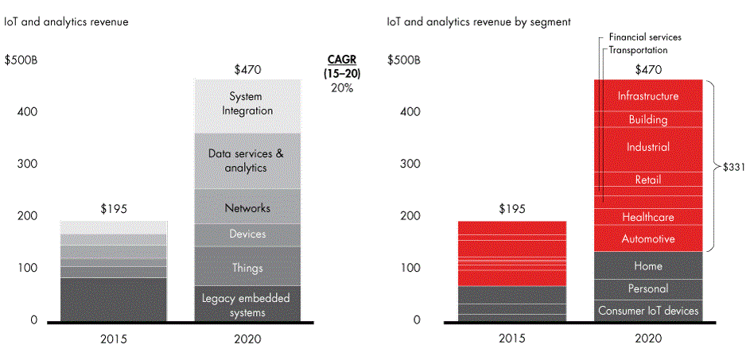
IoT Business and Market Opportunities
* https://towardsdatascience.com/internet-of-things-booming-15-trillion-market-88fde1da2113

Slide 77
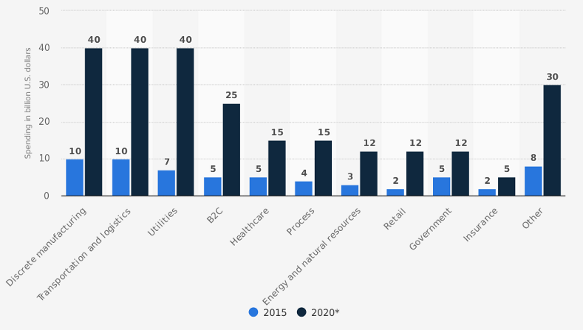
IoT Business and Market Opportunities
* https://discoperi.com/iot_devices_market/
Notes:
An American worldwide consulting agency McKinsey reports that the market of IoT can reach an annual economic impact of $3.9 trillion to $11.1 trillion by 2025 across different sectors, such as plants, smart cities, retail and rental industry, health and insurance, etc.
Such a tremendous growth in the IoT market can be explained by the increase in cloud platforms adoption and its cost-effective services (up to 35% of the annual cost).

Slide 78
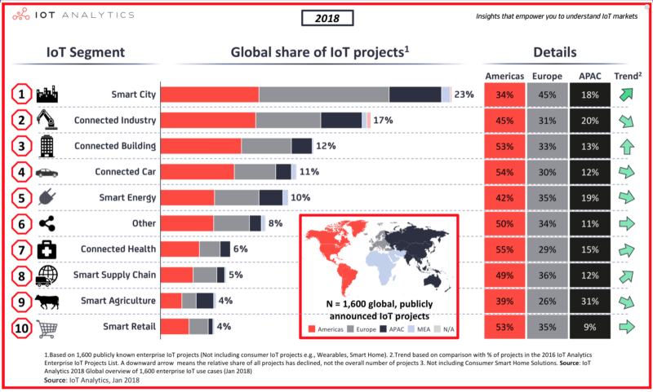
IoT Business and Market Opportunities
* https://discoperi.com/iot_devices_market/
Notes:
An American worldwide consulting agency McKinsey reports that the market of IoT can reach an annual economic impact of $3.9 trillion to $11.1 trillion by 2025 across different sectors, such as plants, smart cities, retail and rental industry, health and insurance, etc.
Such a tremendous growth in the IoT market can be explained by the increase in cloud platforms adoption and its cost-effective services (up to 35% of the annual cost).

Slide 79
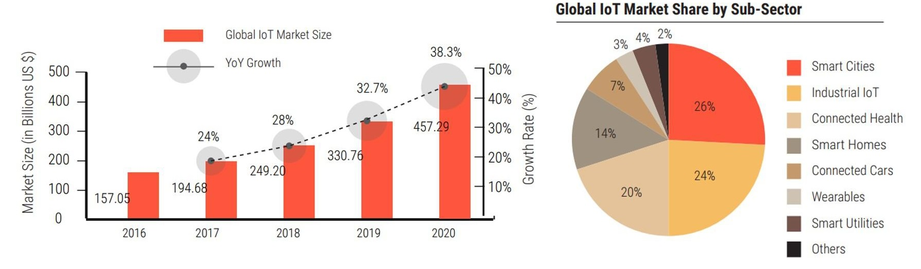
IoT Business and Market Opportunities
* https://dreamziot.com/the-upcoming-iot-market/
Notes:
With urbanization and globalization on the boom, IoT has seen a very promising growth in the market. Acting as a bridge between the physical and the digital world, Internet of Things is enabling various organizations to create a completely different experience not just for themselves but for their consumer as well. In the past couple of years, market statistics reveal that more and more organizations are willing to experiment with IoT because of their higher expectations for ROI from their large-scale initiatives. The KPIs not only indicate operational improvements, supply chain gains, better logistics but also better customer satisfaction.
Let us have a detailed insight into the revenue break up of IoT in the market and where it would stand in the coming years.”According to IDC, worldwide spending on the IoT is forecast to reach $772.5B in 2018. That represents an increase of 15% over the $674B that was spent on IoT in 2017. By the end of 2020, close to 50% of new IoT applications built by enterprises will leverage an IoT platform that offers outcome-focused functionality based on comprehensive analytics capabilities.
The global IoT market will grow from $157B in 2016 to $457B by 2020, attaining a Compound Annual Growth Rate (CAGR) of 28.5%. Discrete Manufacturing, Transportation and Logistics, and Utilities will lead all industries in IoT spending by 2020, averaging $40B each.”

Slide 80
Contents
Basic Concepts and History
Ecosystem
Things
Platform
Networks
Applications and Verticals
Architecture
Challenges
Business and Market Opportunities
Products
Trends

Slide 81
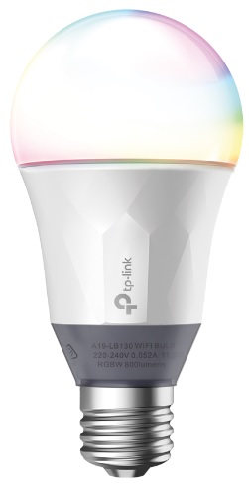
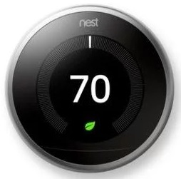

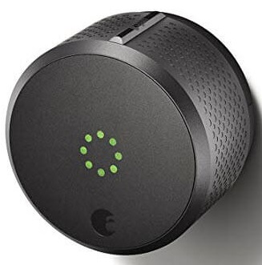
IoT- Products
Kasa Smart Wi-Fi LED Bulb with Multicolour
$29.99
All-new Echo (3rd Gen)- Smart speaker with Alexa
$89.99
August Smart Lock
$ 220
Google Nest Learning Thermostat
$249
Notes:
Kasa Smart Wi-Fi LED Bulb with Multicolour
No Hub Required – Connect the bulb directly to your Wi-Fi at home
Manage Remotely – Easy setup and control from anywhere with the free Kasa app (iOS, Android)
Colour Changing – Fine-tune colours for every occasion and adjust brightness as well as light appearance from soft white (2500k) to daylight (9000k)
Voice Control – Pair to Amazon Alexa and the Google Assistant to enable voice control
Circadian Mode – Dynamically adjust light intensity and temperature to mimic natural light patterns
Save Energy – Reduce energy use up to 80% without brightness or quality loss compared to a 60W incandescent bulb
Compatibility – Compatible with Android, iOS and Amazon Alexa and the Google Assistant
Google Nest Learning Thermostat
Since 2011, Nest thermostats have saved about 49 KWh of energy. The Nest Learning Thermostat is the first thermostat to get ENERGY STAR certified. It learns what temperature you like and builds a schedule around yours. Since 2011, the Nest Thermostat has saved billions of kWh of energy in millions of homes worldwide.* And independent studies showed that it saved people an average of 10% to 12% on heating bills and 15% on cooling bills. So in under two years, it can pay for itself. The Nest Learning Thermostat automatically adapts as your life and the seasons change. Just use it for a week and it programs itself. Nest shows you how much energy you use every day in Energy History and every month in your Home Report. So you can see when you use more energy, like on weekends or Monday nights, and how to use less. With the Nest app, your thermostat lives on your wall and in your pocket. Once you connect your thermostat to Wi-Fi, you can control it from anywhere. Adjust the temperature from the app, and the Nest Thermostat adjusts quickly back at home. The Nest Thermostat is just one part of your heating and cooling system. But it can keep an eye on the rest of it. You’ll get an alert on your phone if there’s something wrong — like temperatures are so low your pipes could burst. And if it looks like your furnace is acting up, the Nest Thermostat will send you an alert.
All-new Echo (3rd Gen)- Smart speaker with Alexa
Voice control your music - Ask Alexa for a song, artist, or genre from Amazon Music, Apple Music, Spotify, Pandora, SiriusXM, and more. With multi-room music, play music on compatible Echo devices in different rooms.
Voice control your smart home - Turn on lights, adjust thermostats, lock doors, and more with compatible connected devices.
Keep your family in sync - Use your Alexa devices like an intercom and talk to any room in the house with Drop In and Announcements.
Alexa has skills - With tens of thousands of skills and counting, Alexa is always getting smarter and adding new skills like tracking fitness, playing games, and more.
Designed to protect your privacy - Built with multiple layers of privacy controls, including a microphone off button that electronically disconnects the mics.
Make your life easier at home. Use your voice to set timers, add items to lists and create calendar events and reminders. You can also check the news, weather or traffic. Ask for sports scores, film screening times or information. For example: “Alexa, add ‘learn to cook’ to my to do list”.
Manage compatible smart home devices using your voice. Switch on the lamp before getting out of bed, turn on the coffee machine on your way to the kitchen, or dim the lights from the sofa to watch a film.
Make hands-free calls to almost anyone including UK mobile and residential numbers (from UK only, emergency calling not supported), other Echo devices and the Alexa app. You can also link Alexa with your mobile phone account to ask Alexa to make and answer your mobile calls (Vodafone UK). Use Announcements to send voice messages to every room with an Echo device, or use Drop In as a two-way intercom between rooms. For example: “Alexa, call mom”.
August Smart Lock
August Smart Lock has proven to be a reliable security IoT device. It allows the user to manage their doors from any location hassle-free. It helps the user to keep thieves away and family in your home.
Allows the user to know about each and every person coming and going into your home.
Provides unlimited digital keys and no fear of stolen key.
It gives the status updates of your door as it is properly closed or not.
It has a good auto-unlock feature and as soon as the user arrives near the door it opens automatically.
Easy installation and is compatible with most standard single cylinder deadbolts.

Slide 82

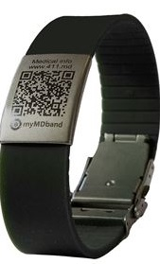
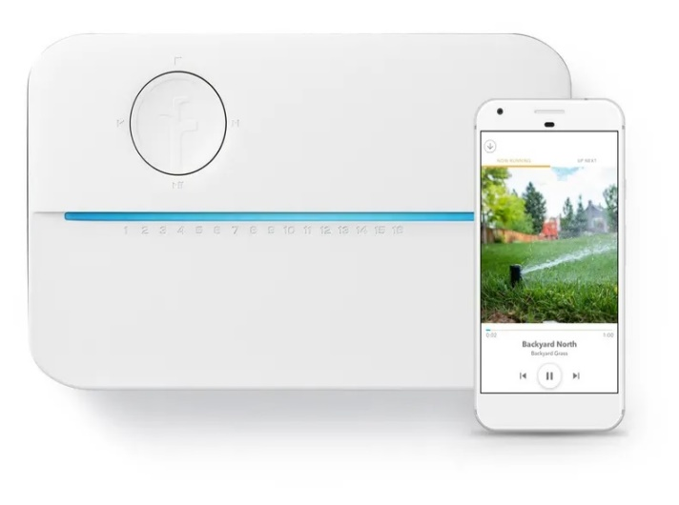
IoT- Products
Rachio 3, Smart Sprinkler Controller
$229.99
MyMDband, Medical Bracelet
$99.99
Aladin home, A magic lamp designed for comfort at home
49,50 €/month

Slide 83
Contents
Basic Concepts and History
Ecosystem
Things
Platform
Networks
Applications and Verticals
Architecture
Challenges
Business and Market Opportunities
Products
Trends

Slide 84
IoT Trends
Artificial Intelligence
Social, Legal, and Ethical IoT
Infonomics and Data Broking
The Shift from Intelligent Edge to Intelligent Mesh
IoT Governance
Sensor Innovation
Trusted Hardware and Operating System
Novel IoT User Experiences
Silicon Chip Innovation
New Wireless Networking Technologies for IoT
* https://www.gartner.com/en/newsroom/press-releases/2018-11-07-gartner-identifies-top-10-strategic-iot-technologies-and-trends
Notes:
Trend No. 1: Artificial Intelligence (AI)
Gartner forecasts that 14.2 billion connected things will be in use in 2019, and that the total will reach 25 billion by 2021, producing immense volume of data. “Data is the fuel that powers the IoT and the organization’s ability to derive meaning from it will define their long term success,” said Mr. Jones. “AI will be applied to a wide range of IoT information, including video, still images, speech, network traffic activity and sensor data.”
The technology landscape for AI is complex and will remain so through 2023, with many IT vendors investing heavily in AI, variants of AI coexisting, and new AI-based tolls and services emerging. Despite this complexity, it will be possible to achieve good results with AI in a wide range of IoT situations. As a result, CIOs must build an organization with the tools and skills to exploit AI in their IoT strategy.
Trend No. 2: Social, Legal and Ethical IoT
As the IoT matures and becomes more widely deployed, a wide range of social, legal and ethical issues will grow in importance. These include ownership of data and the deductions made from it; algorithmic bias; privacy; and compliance with regulations such as the General Data Protection Regulation.
“Successful deployment of an IoT solution demands that it’s not just technically effective but also socially acceptable,” said Mr. Jones. “CIOs must, therefore, educate themselves and their staff in this area, and consider forming groups, such as ethics councils, to review corporate strategy. CIOs should also consider having key algorithms and AI systems reviewed by external consultancies to identify potential bias.”
Trend No. 3: Infonomics and Data Broking
Last year’s Gartner survey of IoT projects showed 35 percent of respondents were selling or planning to sell data collected by their products and services. The theory of infonomics takes this monetization of data further by seeing it as a strategic business asset to be recorded in the company accounts. By 2023, the buying and selling of IoT data will become an essential part of many IoT systems. CIOs must educate their organizations on the risks and opportunities related to data broking in order to set the IT policies required in this area and to advise other parts of the organization.
Trend No. 4: The Shift from Intelligent Edge to Intelligent Mesh
The shift from centralized and cloud to edge architectures is well under way in the IoT space. However, this is not the end point because the neat set of layers associated with edge architecture will evolve to a more unstructured architecture comprising of a wide range of “things” and services connected in a dynamic mesh. These mesh architectures will enable more flexible, intelligent and responsive IoT systems — although often at the cost of additional complexities. CIOs must prepare for mesh architectures’ impact on IT infrastructure, skills and sourcing.
Trend No. 5: IoT Governance
As the IoT continues to expand, the need for a governance framework that ensures appropriate behavior in the creation, storage, use and deletion of information related to IoT projects will become increasingly important. Governance ranges from simple technical tasks such as device audits and firmware updates to more complex issues such as the control of devices and the usage of the information they generate. CIOs must take on the role of educating their organizations on governance issues and in some cases invest in staff and technologies to tackle governance.
Trend No. 6: Sensor Innovation
The sensor market will evolve continuously through 2023. New sensors will enable a wider range of situations and events to be detected, current sensors will fall in price to become more affordable or will be packaged in new ways to support new applications, and new algorithms will emerge to deduce more information from current sensor technologies. CIOs should ensure their teams are monitoring sensor innovations to identify those that might assist new opportunities and business innovation.
Trend No. 7: Trusted Hardware and Operating System
Gartner surveys invariably show that security is the most significant area of technical concern for organizations deploying IoT systems. This is because organizations often don’t have control over the source and nature of the software and hardware being utilised in IoT initiatives. “However, by 2023, we expect to see the deployment of hardware and software combinations that together create more trustworthy and secure IoT systems,” said Mr. Jones. “We advise CIOs to collaborate with chief information security officers to ensure the right staff are involved in reviewing any decisions that involve purchasing IoT devices and embedded operating systems.”
Trend 8: Novel IoT User Experiences
The IoT user experience (UX) covers a wide range of technologies and design techniques. It will be driven by four factors: new sensors, new algorithms, new experience architectures and context, and socially aware experiences. With an increasing number of interactions occurring with things that don’t have screens and keyboards, organizations’ UX designers will be required to use new technologies and adopt new perspectives if they want to create a superior UX that reduces friction, locks in users, and encourages usage and retention.
Trend No. 9: Silicon Chip Innovation
“Currently, most IoT endpoint devices use conventional processor chips, with low-power ARM architectures being particularly popular. However, traditional instruction sets and memory architectures aren’t well-suited to all the tasks that endpoints need to perform,” said Mr. Jones. “For example, the performance of deep neural networks (DNNs) is often limited by memory bandwidth, rather than processing power.”
By 2023, it’s expected that new special-purpose chips will reduce the power consumption required to run a DNN, enabling new edge architectures and embedded DNN functions in low-power IoT endpoints. This will support new capabilities such as data analytics integrated with sensors, and speech recognition included in low cost battery-powered devices. CIOs are advised to take note of this trend as silicon chips enabling functions such as embedded AI will in turn enable organizations to create highly innovative products and services.
Trend No. 10: New Wireless Networking Technologies for IoT
IoT networking involves balancing a set of competing requirements, such as endpoint cost, power consumption, bandwidth, latency, connection density, operating cost, quality of service, and range. No single networking technology optimizes all of these and new IoT networking technologies will provide CIOs with additional choice and flexibility. In particular they should explore 5G, the forthcoming generation of low earth orbit satellites, and backscatter networks

Slide 85
IoT Trends
Focus on Security
IoT in Manufacturing
Big Data, Analytics, and Machine Learning
Healthcare Spearheads IoT Adoption
Better Workforce Management
The Emergence of Smart Cities
Cloud Vendors to Zero In on IoT
IoT in Customer Service
Developers to Come Up with IoT Milestones
Powering Smart Stores
* https://financesonline.com/iot-trends/

Slide 86
IoT Trends in 2020
Industrial, Automotive Sectors Will Drive IoT Data Growth
IoT Metadata Becomes Increasingly Important
Building Automation, Lighting Will Lead IoT Endpoint Growth
Wireless Sensing, Location Tracking Will Become More Relevant
Resilient Energy, Infrastructure Will Drive Smart City Initiatives
* https://www.crn.com/slide-shows/internet-of-things/5-emerging-iot-trends-to-watch-in-2020/

Slide 87
IoT Trends in 2020
Healthcare industry will be seeing the emergence of IoT
The new era of Smart Cities
Ethical and legal concerns
Education and Training will be more focussed in the coming years
Blockchain as an efficient backend
There will be more appliances on IOT than people
* https://medium.com/datadriveninvestor/top-iot-trends-that-will-be-dominating-2020-3cbd4678da2e

Slide 88
IoT Trends in 2020
Growth in data and devices with more human-device interaction
AI, a big player in IoT
Voice User Interface (VUI) will be a reality
More investments in IoT
A real expansion of smart IoT
The rise of industrial IoT and digital twin technology
More movement to the edge
IoT focus on security using blockchain
More social, legal, and ethical issues
Standardization still a problem
* Ten Trends of IoT in 2020, San Jose University, USA, 2019
Notes:
TREND 1: Growth In Data And Devices With More Human-device Interaction
By the end of 2019, there will be are around 3.6 billion devices that are actively connected to the Internet and used for daily tasks. With the introduction of 5G that will open the door for more devices, and data traffic. You can add to this trend the increase adoption of edge computing which will make it easier for business to process data faster and close to the points of action.
Trend 2: Ai A Big Player In IoT
Making the most of data, and even understanding on a basic level how modern infrastructure functions, requires computer assistance through artificial intelligence. The major cloud vendors, including Amazon, Microsoft, and Google, are increasingly looking to compete based on their AI capabilities. Various startups hope to increase their market share through AI algorithms able to leverage machine learning and deep learning, allowing businesses to extract more value out of their ever-growing volumes of data.
Artificial intelligence is the fundamental ingredient needed to make sense of the vast amount of data collected these days, and increase its value for the business. AI will help IoT data analysis in the following areas: data preparation, data discovery, visualization of streaming data, time series accuracy of data, predictive and advance analytics, and real-time geospatial and location (logistical data).
Trend 3: VUI: Voice User Interface Will Be A Reality
It’s a battle among industry leaders who would like to dominate the market of IoT at an early stage. Digital assistant devices, including HomePod, Alexa, Siri, and Google Assistant, are the future hubs for the next phase of smart devices, and companies are trying to establish “their hubs” with consumers, to make it easier for them to keep adding devices with less struggle and no frustrations.
Voice represents 80% of our daily communications, taking a chapter from Sci-Fi movies, talking to robots is the common way of communications, R2D2, C-3PO, and Jarvis to name a few. The use of voice in setting up the devices, change that setups, giving commands and receiving results will be the norm not only in smart houses, factories but in between like cars, wearables for example.
Trend 4: More Investments In IoT
IoT’s undisputable impact has and will continue to lure more startup venture capitalists towards highly innovative projects in hardware, software, and services. Spending on IoT will hit 1.4 trillion dollars by 2021.
IoT is one of the few markets that have the interest of the emerging as well as the traditional venture capitalists. The spread of smart devices and the increasing dependency of customers to do many of their daily tasks using them will add to the excitement of investing in IoT startups. Customers will be waiting for the next big innovation in IoT—such as smart mirrors that will analysis your face and call your doctor if you look sick, smart ATM machine that will incorporate smart security cameras, smart forks that will tell you how to eat and what to eat, and smart beds that will turn off the lights when everyone is sleeping.
Trend 5: Finally, A Real Expansion Of Smart IoT
IoT is all about connectivity and processing, nothing will be a better example than smart cities, but smart cities have been in a bit of a holding pattern recently. Smart sensors around the neighborhood will record everything from walking routes, shared car use, building occupancy, sewage flow, and temperature choice 24/7 with the goal of creating a place that’s comfortable, convenient, safe, and clean for those who live there. Once the model is perfected, it could be the model for other smart neighborhoods and eventually smart cities. The potential benefits for cities, however, make IoT technology especially compelling. Cities of all sizes are exploring how IoT can lead to better efficiency and safety, and this infrastructure is increasingly being rolled around the world. Transportation will likely lead this change, as bringing connectivity, intelligence and automation to roads and public transportation has proven to significantly improve efficiency and experience. One factor expected to play a role in smart city development will be 5G, making the lightning-fast transfer of streaming analytics more realistic. 5G rollouts will spur a race to build applications that tap into the numerous market opportunities it creates.
Another area of spreading smart IoT is the auto industry with self-driving cars become a normal occurrence in the next few years, today tons of vehicles have a connected app that shows up to date diagnostic information about the car. This is done with IoT technology, which is the heart of the connected vehicle. Diagnostic information is not the only IoT advancement that we will see in the next year or so. Connected apps, voice search, and current traffic information are a few other things that will change the way we drive.
Trend 6: The Rise Of Industrial IoT & Digital Twin Technology
An amalgamation of technologies is pushing this new techno-industrial revolution, and IoT plays a big part in making manufacturing more efficient, less risky, and more profitable. Industrial IoT brings enhanced efficiency and productivity through data integration and analysis in a way that isn’t possible without an interconnected manufacturing process.
Another notion that is gaining popularity is “digital twin” technology. Through its use, organizations can create a clear picture of how their IoT devices are interacting with the manufacturing process. This gives keen businesses insight into how the life cycle of their machines operates and allows them to predict changes that may be needed ahead of time. According to a Gartner survey, 48% of smart manufacturing adopters have made plans to make use of the digital twin concept.
Trend 7: More Movement To The Edge
Edge computing is a technology that distributes the load of processing and moved it closer to the edge of the network (sensors in case of IoT). The benefits of using fog computing are very attractive to IoT solution providers. Some of these benefits allow users to minimize latency, conserve network bandwidth, operate reliably with quick decisions, collect and secure a wide range of data, and move data to the best place for processing with better analysis and insights of local data. Edge computing has been on the rise in recent years, but the growing scope of IoT technology will make this move even more pronounced. Two factors are leading this change:
Powerful edge devices in various form factors are becoming more affordable.
Centralized infrastructure is becoming more stressed.
Edge computing also makes on-device AI a realistic proposition, as it allows companies to leverage real-time data sets instead of having to sift through terabytes of data in a centralized cloud in real-time. Over the coming years and even decades, it’s likely that tech will shift to a balance between the cloud and more distributed, edge-powered devices.
Hardware manufacturers are building specific infrastructure for the edge deigned to be more physically rugged and secure, and security vendors will start to offer endpoint security solutions to their existing services to prevent data loss, give insights into network health and threat protection, include privileged user control and application whitelisting and control, that will help in the fast adoption and spread of edge computing implementations by businesses.
Trend 8: IoT Focus On Security Using Blockchain
The IoT tech market will see a renewed focus on security as complex safety challenges crop up. These complexities stem from the diverse and distributed nature of the technology. The number of Internet-connected devices has breached the 26 billion mark. Device and IoT network hacking will become commonplace in 2020. It is up to network operators to stop intruders from doing their business.
The current centralized architecture of IoT is one of the main reasons for the vulnerability of IoT networks. With billions of devices connected and more to be added, IoT is a big target for cyber-attacks, which makes security extremely important.
Blockchain offers new hope for IoT security for several reasons. First, blockchain is public, everyone participating in the network of nodes of the blockchain network can see the blocks and the transactions stored and approves them, although users can still have private keys to control transactions. Second, blockchain is decentralized, so there is no single authority that can approve the transactions eliminating Single Point of Failure (SPOF) weakness. Third and most importantly, it’s secure—the database can only be extended and previous records cannot be changed.
In the coming years, manufacturers will recognize the benefits of having blockchain technology embedded in all devices and compete for labels like “Blockchain Certified”.
Trend 9: More Social, Legal, And Ethical Issues
IoT devices represent a largely unregulated new technology. IoT will inevitably find itself facing social and legal questions in the near future. This is particularly relevant for data collected by these devices, which may soon find itself falling under the umbrella of the General Data Protection Regulation (GDPR). This regulation regarding the handling of personal data and privacy in the European Union, the GDPR extends its reach beyond the European region. Any business that wants to successfully operate within the EU will need to comply with the guidelines laid out in its 88-page document. Security issues are essential when it comes to the legal regulation of personal data. Development teams can ensure the required level of security and compliance on various levels, including data encryption, active consent, various means of verification and other mechanisms. Their goal is to collect data legitimately and keep its accessibility, processing, and storage to a minimum that is dictated by the software product.
Trend 10: Standardization Still A Problem
Standardization is one of the biggest challenges facing the growth of IoT—it’s a battle among industry leaders who would like to dominate the market of IoT at an early stage. But what we have now is a case of fragmentation. One possible solution is to have a limited number of vendors dominating the market, allowing customers to select one and stick to it for any additional connected devices, similar to the case of operating systems we have now have with Windows, Mac, and Linux for example, where there are no cross-platform standards.
To understand the difficulty of standardization, we need to deal with all three categories in the standardization process: Platform, Connectivity, and Applications. In the case of the platform, we deal with UX/UI and analytic tools, while connectivity deals with customer’s contact points with devices, and last, applications are the home of the applications which control, collect and analyze data. All three categories are inter-related and we need them all, missing one will break that model and stall the standardization process. There is no way to solve the problem of fragmentation without a strong push by organizations like IEEE or government regulations to have common standards for IoT devices.

Slide 89
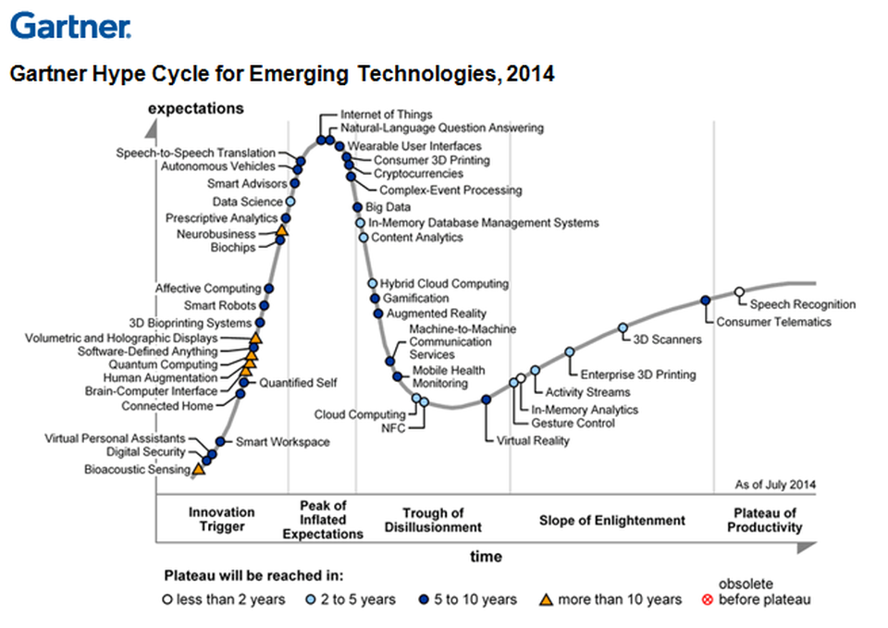
IoT Trends
* https://gartner.com

Slide 90
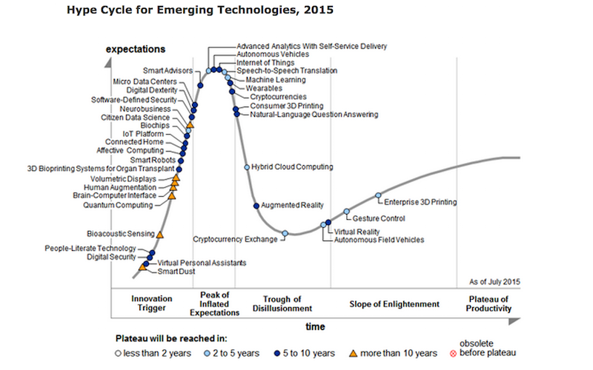
IoT Trends
* https://gartner.com

Slide 91
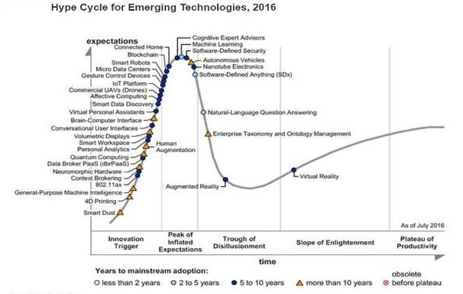
IoT Trends
* https://gartner.com

Slide 92
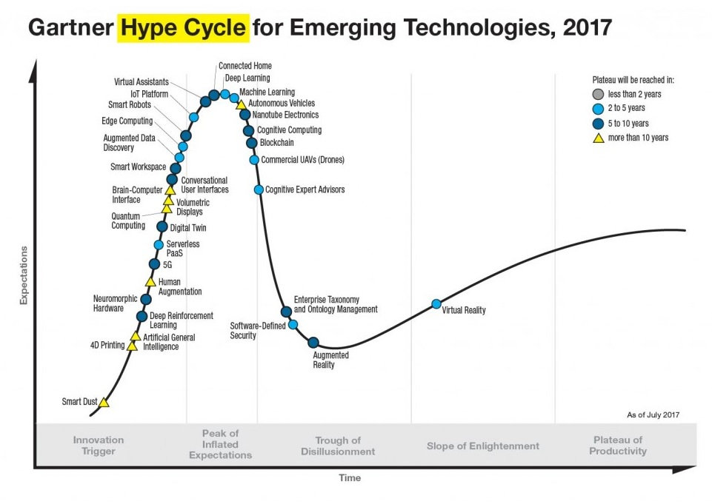
IoT Trends
* https://gartner.com

Slide 93
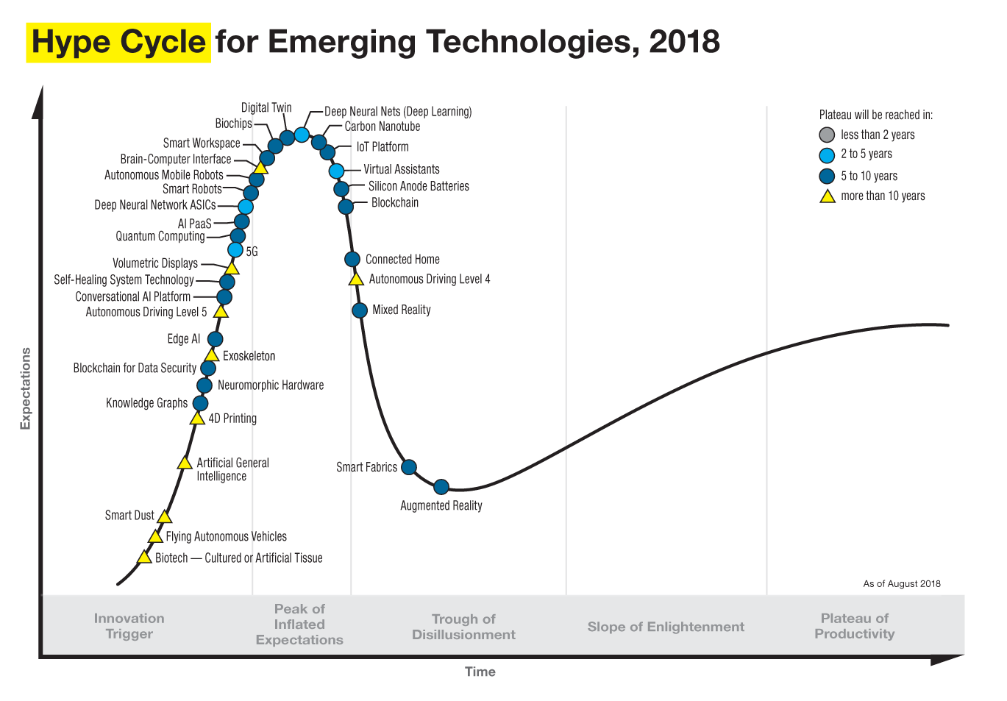
IoT Trends
* https://gartner.com

Slide 94
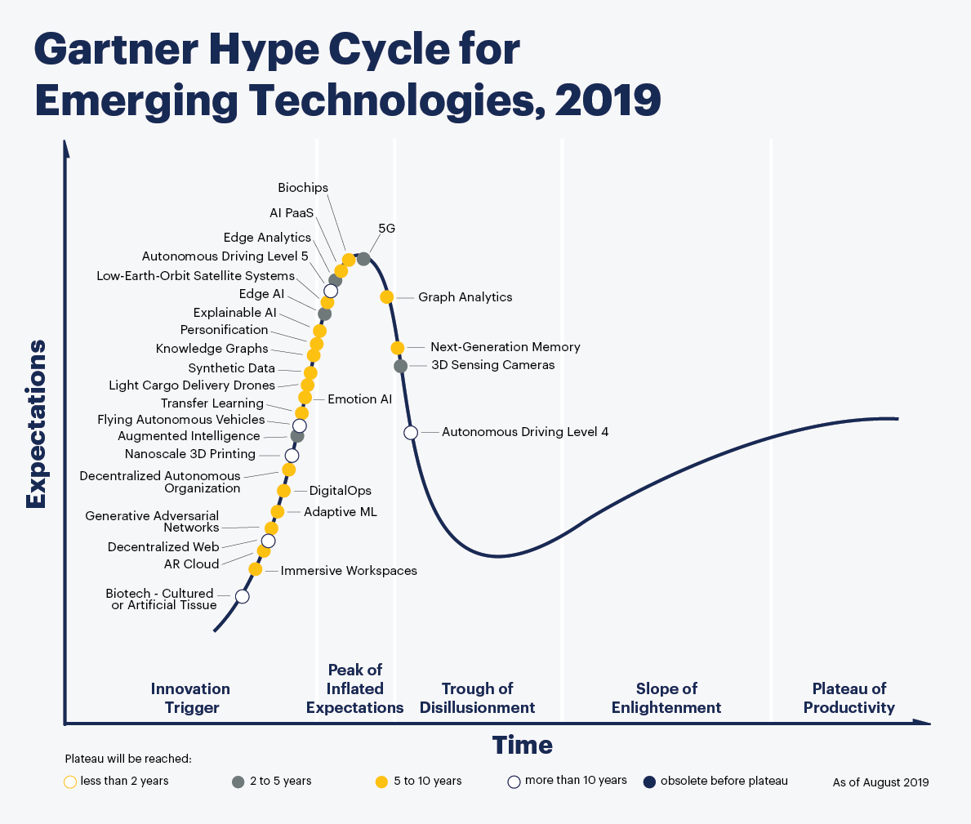
IoT Trends
* https://gartner.com
Notes:
why does not gartner hype cycle 2019 include iot?
Edge AI – Edge AI refers to the use of AI techniques embedded in IoT endpoints, gateways, and edge devices, in applications ranging from autonomous vehicles to streaming analytics. (https://www.enterpriseirregulars.com/144131/whats-new-in-gartners-hype-cycle-for-ai-2019/)

Slide 95
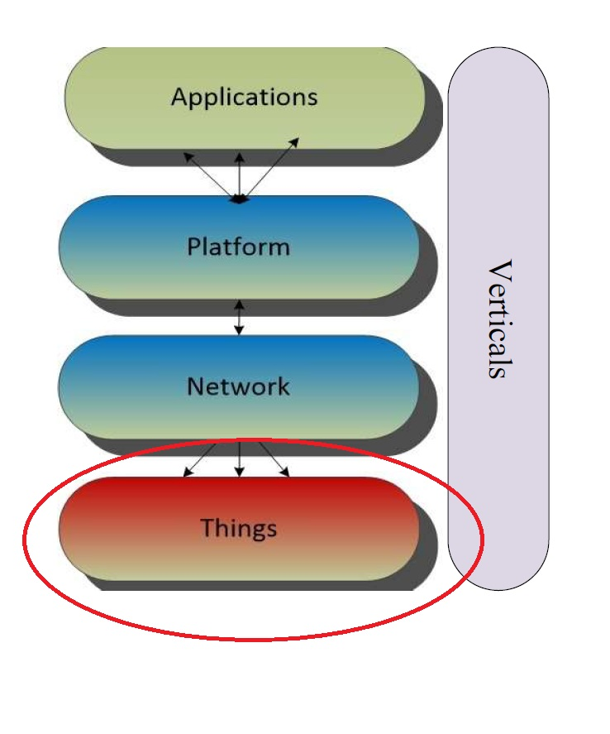
Next Lecture
An overview of
Electronic
Microcontrollers
Things (sensors and actuators)
gateways

